Slide 1
Microsoft SOA Technologies (Part 2)
CoreGRID Summer School, Dortmund
Holger Sirtl
Architect Evangelist
Developer Platform & Strategy Group, Microsoft Deutschland GmbH
http://blogs.msdn.com/hsirtl

Slide 2


Agenda
SOA Consume
SOA
SOA Roadmap
Software + Services
Cloud Platform
Notes:
SOA Consume:
-What is available today?
SOA Roadmap:
What will be available soon/in future?
Software + Services:
The broader vision for future IT (and where is SOA?)
Cloud Platform:
-One aspect of this vision

Slide 3
SOA Consume

Slide 4

User From Architect‘s Viewpoint
User
Notes:
Architects often behave as it users accessed a SOA directly.
They care about service exposure, composition/orchestration, and standards based interoperability.

Slide 5

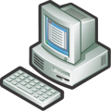
SOA From User‘s Viewpoint
User
Notes:
The user doesn’t really care, how the functionality is architected, designed, implemented, operated and monitored.
As long as everything works fine…

Slide 6

SOA from Manager‘s Viewpoint
Manager
User
User
User
User
User
Notes:
Managers often see SOA as a common platform for users to interact.
However, a SOA usually has orchestration that covers system processes (design time!).

Slide 7






„Real Life“ Information Work
Estimate custom design
85%
Get specs from customer
Validate specs with Tech Sales
Cost out the solution
Decide discount strategy
Assemble proposed response
Approve proposed response
CRM
ERP
Qualified?
Closed ?
Create Lead
Create Oppt‘y
Create Quote
Complete Sale
Create Invoice
Retire Lead
15%
Notes:
7
Going from the outside in.
Most people already know the truth: business processes are far more complex than the simple diagrams here.
Each individual step involves lots of backandforth, document creation, presentations, negotiations etc.
Backend systems don’t assist this true process, just capture the transaction
This leads to overhead, double work, cut and paste integration and error potential
Plays out in many scenarios across many departments
Results in poor adoption and poor success rates
Much of this ad-hoc, or real-world process work occurs in tools like Microsoft Office.
7

Slide 8



Process Characteristics
Human Centric
System Centric
Long running
Collaboration
Focus on roles
Organizational
Semi-structured to unstructured
Usability, UI-centric
Tasklist Managment
Escalation, Delegation
Transactional
Messaging
Decoupling
Throughput
Performance
Service Orientation
B2B, RFID, EDI
System Integration

Slide 9
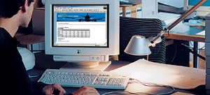


Process Optimization Potential
With Business Process Management cycle times can be reduced by 40%
Typical Business Process
Idle period: 80%
Processing time: 20%
Processing time optimization
(Typical approach of ERP and CRM)
50% reduction of the processing time
10% reduction of the cylce time
Idle period reduction is
the main Focus of BPM
50% reduction of the idle period
40% reduction of the cycle time
Notes:
(Independent!) Research Shows: BPM can optimize IT-supported BP steps by 40%.
If only 20% are IT-supported: Only (about) 10% optimization.
If we extend the IT-support (reduce idle period by 50%): additional 40% optimization.
So what we’ve seen so far (basic SOA), is incomplete…

Slide 10
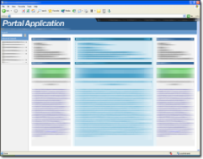









SOA for Transaction and Interaction
Consume
User Directed
Business Innovation
Value Justified
LOB Manager Driven
Compose
User Experience and Interaction
People using Content, BI,
Collaboration and Communication
SOA as mechanism
to interact
Standards based Interoperability
Compose
Business Process Integration,
Automation and Optimization,
Information Integration
SOA as mechanism
to transact
Compliance and Evolution
Cost Justified
CFO/CIO Driven
Expose
Existing Systems
Notes:
Basic SOA: a mechanism to transact.
Implementation: Expose → Compose (system processes)
Now: Extend SOA to cover also human interaction/processes.
Implementation: Compose 2 → Consume
Consume via various clients:
Web Portal
Web 2.0 Social Network
Office
Rich Client (Windows)
Devices
In the middle: Interoperability.
Talking about Services: What services are offered in the different layers…

Slide 11
Application Platform for SOA & BPM
Consume
User Directed
Security and Identity
Management and Governance
Design and Development
Compose
User Interaction
Presentation Services
Collaboration Services
Composition Services
Compose
Process Integration
Business Process Services
Information Integration Services
Messaging
Services
Connectivity Services
Expose
Existing Systems
Notes:
Services…
What Microsoft products offer these services?...

Slide 12
Application Platform for SOA & BPM
Consume
User Directed
Active Directory
System Center, MOF, Partners
Visual Studio. Patterns & Practices, MSF
Compose
User Interaction
MOSS, .NET CF, ASP.NET/AJAX, Silverlight, WPF
MOSS & Office Communications Server
SharePoint Server (MOSS), WF, CAB
Compose
Process Integration
BizTalk Server
WF
SQL Server
BizTalk Server
Windows
WCF
BizTalk Server, WCF
Expose
Existing Systems
Notes:
This is a platform that covers system and human workflows.
How do you implement applications on top of this platform that allows BPM…

Slide 13















„Real Life“ Application Support
Office Business Applications
Word
Excel
Outlook
InfoPath
Estimate custom design
85%
Microsoft Office SharePoint Server
Get specs from customer
Validate specs with Tech Sales
Cost out the solution
Decide discount strategy
Assemble proposed response
Approve proposed response
Estimate custom design
Unstructured
“Classic” Business Applications
CRM
ERP
Qualified?
Closed ?
Create Lead
Create Oppt‘y
Create Quote
Complete Sale
Create Invoice
Retire Lead
15%
Notes:
13
We’ve seen this picture before…
The bottom part is covered by “classic” business applications.
The upper part is covered by something we call Office Business Applications (OBA).
OBAs are built on top of the Office Business Platform.
The two main components of the OBP are:
Office Client
SharePoint Server
A closer look onto these two components and their capabilities…
13

Slide 14
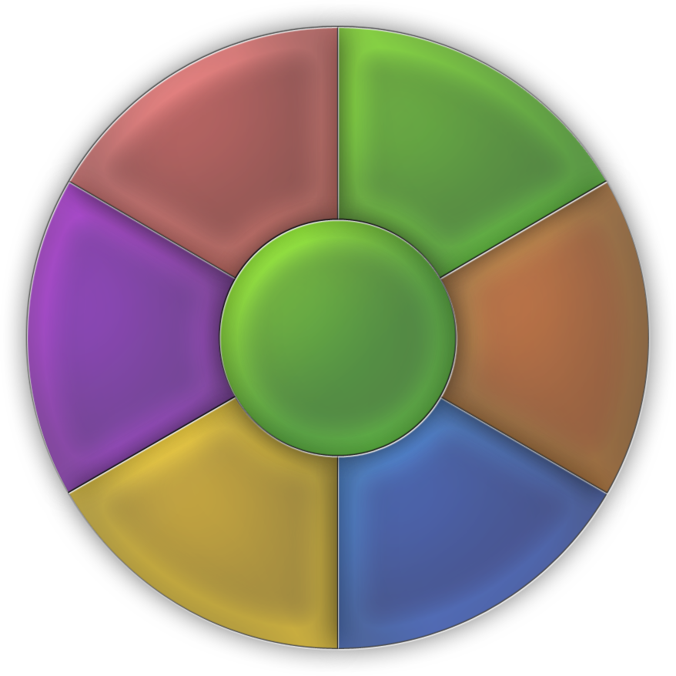
SharePoint Feature Areas
Server-based Excel spreadsheets and data visualization, Report Center, BI Web Parts, KPIs/Dashboards
Docs/tasks/calendars, blogs, wikis, e-mail integration, project management “lite”, Outlook integration,
offline docs/lists
Business
Intelligence
Collaboration
Platform
Services
Rich and Web forms based front-ends, LOB actions, pluggable SSO
Enterprise Portal template, Site Directory, My Sites, social networking, privacy control
Business
Processes
Portal
Workspaces,
Mgmt, Security,
Storage, Topology,
Site Model
Content
Management
Search
Integrated document management, records management, and Web content management with policies and workflow
Enterprise scalability,
contextual relevance, rich
people and business data search

Slide 15
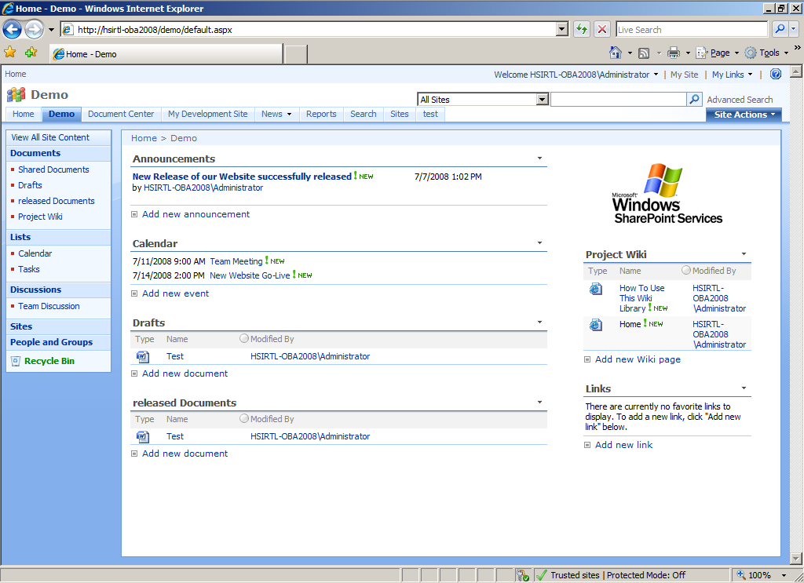

Slide 16
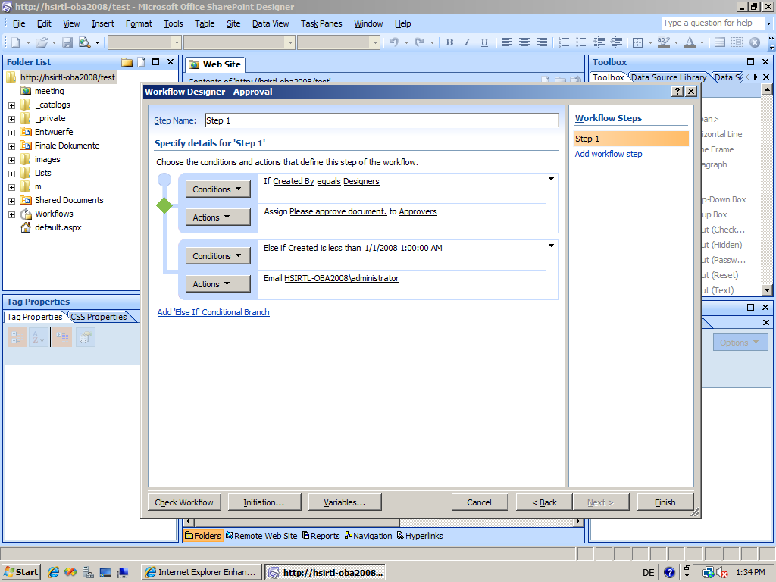

Slide 17
SharePoint Developer Map
Microsoft
Office
SharePoint
Server 2007
Business Intelligence
Excel Services
Reporting and Dashboards
BPI / BPM
Form Services
BDC
ECM
Web Content Management
Document and Records Management
Enterprise Search
People and Personalization
Windows
SharePoint
Services
Version 3
Site Provisioning
Provisioning Framework
Solution Deployment
SharePoint Data Store
Services
Import / Export
E-Mail and Alerts
RSS
Search
.NET Developer APIs
Object Model
Web Services
Events
Content Management
Workflow
Schema Management
Versioning
Check-in/-out
Documents
Administration
Configuration
Timers
Data
Site Model
Lists and Libraries
Lookups
Security
Query
Pages and UI
Web Parts
UI and Navigation
Forms and Views
Pages
Windows Internal Database /
SQL Server 2005 /
SQL Server 2008
ASP.NET 2.0
Windows Workflow Foundation
IIS 6 / IIS 7
.NET Framework 3.x
Windows Server 2003 / Windows Server 2008
Notes:
Important aspects
-All these elements can be accessed via WebServices
-.NET Developer API (extensions can be implemented in .NET)
-Eventing System
The other important part of the Office Platform…

Slide 18

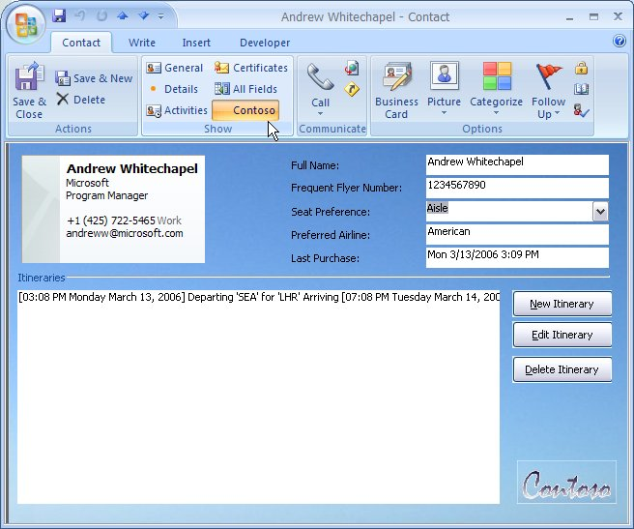
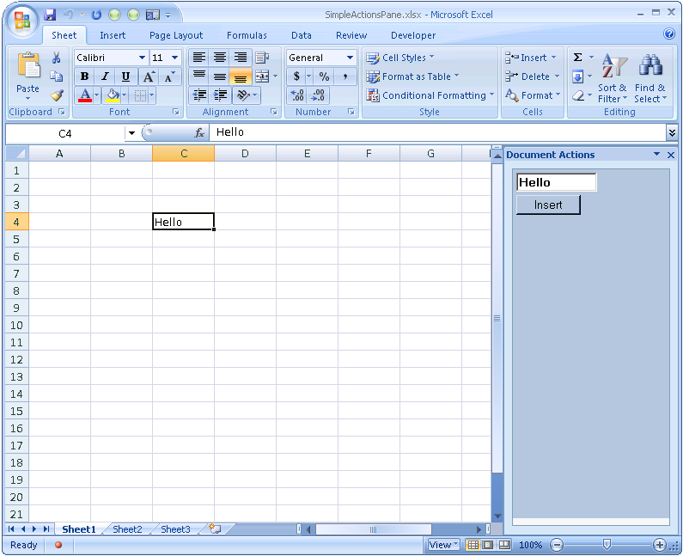

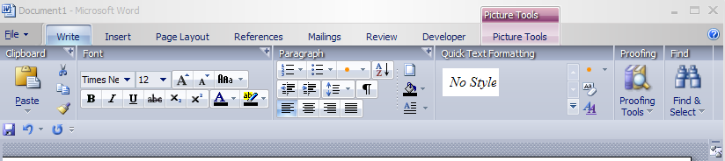
Visual Studio Tools For Office (VSTO)
Actions Pane
Outlook custom form regions
Ribbon Customization
Ribbon
Group
Control
Tab
Notes:
Office Client
VSTO offers an extension model for Office clients that allows you to implement extensions/customizations in .NET.
How does the architecture of an OBA (that is used as a consumer for a SOA) look like…

Slide 19
Office Business Applications
Layered Architecture
Presentation
Layer
Visual Studio Tools for Office
SharePoint Designer
SharePoint Site Template & Site Customizations
Visual Studio
Business Scorecard Manager
SharePoint Admin Console
Visual Studio
SQL Server Mgmt Studio
Office Client
Applications
Ribbons
Action Pane
Task Pane
Form Region
Portal
Sites
Pages
Web Parts
Productivity
Layer
Document Library
Forms Library
Sharepoint Lists, Actions
KPIs, Metrics, Reports, Dashboards
Excel Services
Workflows / Process Orchestration
Business Data Catalog
Application
Layer
Web Services
LOB, SCM, ERP, Legacy, …
Data
Layer
Analysis Services
Identity Store
Data Store
Data Warehouse
Development Tools
Notes:
What products cover these functional blocks…

Slide 20



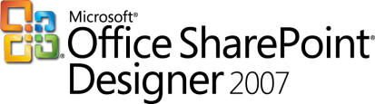




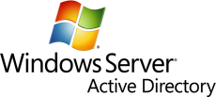



Office Business Applications
Application and Server Stack
Presentation
Layer
Visual Studio Tools for Office
SharePoint Designer
SharePoint Site Template & Site Customizations
Visual Studio
Business Scorecard Manager
SharePoint Admin Console
Visual Studio
SQL Server Mgmt Studio
Office Client
Applications
Ribbons
Action Pane
Action Pane
Form Region
Portal
Sites
Pages
Web Parts
Productivity
Layer
Document Library
Forms Library
Sharepoint Lists, Actions
KPIs, Metrics, Reports, Dashboards
Excel Services
Workflows / Process Orchestration
Business Data Catalog
WCF
WF
Application
Layer
Web Services
Business Applications (SAP, Siebel, Oracle, Dynamics)
LOB, SCM, ERP, Legacy, …
Data
Layer
Analysis Services
Identity Store
Data Store
Data Warehouse
Development Tools
Notes:
Now we‘ve seen a couple of ways how to implement workflows/processes:
-In WF
-In BizTalk
-In SharePoint
How does this look like in an overall scenario…

Slide 21
Microsoft
SOA Roadmap

Slide 22

IT Today
Working in a complex world
Business Process
SLA
Service
Activity
Computer
Application
Data Center
Workflow
Notes:
Imagine the business comes to you complaining that a service level agreement isn’t being met. How do you determine where the problem is? First, you’ve got to figure out which application supports this part of the process—not always an easy thing to do.
Once the app is identified, you might first suspect that the problem is in the data center. This means that you’ve got to find the right computer in the right data center, talk to the right person—its admin—and work things out. How easy is this?
If this doesn’t help, the problem might actually be in the app itself. Perhaps the logic of the workflow is wrong—we’ve misunderstood something when we implemented it—and the business analyst who defined this workflow might be able to help. Sadly, she can’t read C#--she defines workflows using Visio—so she can’t really be helpful.
Or maybe, in this brave new service-oriented world, one of the activities in the workflow exposes a service, and there’s a problem with this service. An architect with a global knowledge of our organization’s services might be able to help us here, but again, he’s got his own descriptions of the architecture. He also can’t help.
Does this sound like your world?

Slide 23





Who Cares About What?
Different people, different concerns
Business Analyst
IT Pro
Enterprise Architect
Developer
Notes:
Right now, the information needed to solve this problem is fragmented, stored in different ways and accessed by different tools. There usually aren't connections between these information silos, and so it's tough to do things like track a problem or make a change across the entire environment.
Suppose, for example, that this business process changes so that the SLA on this service gets more stringent, or perhaps another business process wants to use this service. How in the world can anybody figure this out? What has to change to make this happen? Today we rely on email or Word documents or human contact—it’s a difficult process.

Slide 24
"Oslo"
Defining terms
"Oslo" refers to a group of forthcoming Microsoft products and technologies
  It's not the code name for a single new product or new release of a product
The "Oslo" technologies this talk focuses on are:
  Interoperability scenarios
  A new repository with a visual editor
  A new process server for WF, WCF, BizTalk, and other applications

Slide 25
Simplifying Interoperability
Extended by hundreds of solutions from the partner ecosystem
BizTalk Services – “Interop in the Cloud”
Federated Identity
Federated Connectivity
Federated Workflow
BizTalk Server – “Interop In the Box”
LOB formats:
SAP
Siebel Applications
PeopleSoft Enterprise
JD Edwards
OneWorld
JD Edwards
Enterprise One
B2B formats:
XML
EDI (EDIFACT, ANSI X12, HIPAA)
AS2
SWIFT
HL7
RosettaNet
Messaging formats:
WebSphere MQ
MSMQ/MSMQT
TIBCO Rendezvous
TIBCO Enterprise
Message Service
Legacy formats:
IBM CICS
IBM IMS
IBM OS/400
IBM DB2
IBM VSAM
Other formats:
SQL Server
SharePoint
Oracle DBMS
File, FTP
HTTP, SOAP
POP3 / SMTP
Windows Communication Foundation – “Interop in the Framework”
Unified protocols:
ASMX
WSE
.NET Remoting
COM+
MSMQ
Messaging:
SOAP, WS-Addressing, MTOM
Metadata:
WSDL, WS-MetadataExchange,
WS-Policy
Security:
WS-Security, WS-SecureConversation, WS-Trust
Reliability and Transactions:
WS-Reliable Messaging, WS-Coordination,
WS-AtomicTransaction
Web 2.0
POX
REST
JSON
RSS/ATOM

Slide 26
Where is "Oslo"?
A status report
More about "Oslo" at PDC later this year
  No release dates have yet been announced
The goal today:
  Describe some of the main problems “Oslo” addresses
  Give you a big-picture view of the technology
Don’t be surprised if there are changes before the first “Oslo” release
  Some things are sure to change, e.g., screen shots

Slide 27





Oslo
APPLICATIONS
SERVICES
“6”
Services “1”
“10”
“5”
“4”
MODELS
Oslo
A New Way to Build Applications
Notes:
Models
Moving from imparative programming to declaratively describing an application
Services
→ Components that can be assembled, deployed, monitored in composite applications

Slide 28
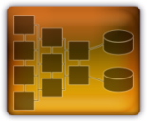
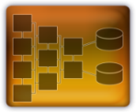
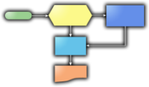



Oslo Components
Repository
Database to store and
share models
Modeling Language
An approachable, mainstream, textual modeling language for describing both data (e.g. requirements) and behavior (e.g.workflow)
Process Server
A full featured execution environment for workflow, rules, and any .NET service.
Modeling Tools
Create, edit,
and browse models
Bus Analyst
Arch
Dev
IT Pro
Cloud Services
A set of Microsoft hosted services including a service bus and a process server
Service Bus
Allows services to discover and communicate with each other
Modeling Tools
Modeling Language
Model Repository
Process Server
Service Bus
Cloud Services

Slide 29
The "Oslo" Repository
A common store for diverse information
Provides one place to find information about the IT environment
Examples of what the repository allows:
  People in different roles can see and modify a common set of information
    About applications, business processes, or anything else
  Relationships between information can be made apparent
  Problems can be tracked from end to end:
Workflow
Activity
Service
Business
Process
SLA
Application
Computer
Data Center
Notes:
Microsoft sometimes refers to this information as “models”.

Slide 30
What's in the Repository
Some examples of pre-defined schemas
Schema
What It Describes
Process
The steps in a process, e.g., a business process
ServiceLevelAgreement
Requirements defined by an SLA
Workflow
A WF workflow
Activity
A specific activity in a WF workflow
Service
A service provided by an application; can run locally or remotely
Application
A (possibly composite) application
Computer
A physical computer
Environment
A set of machines, software, etc. on which an application can be deployed
Notes:
Some examples of why this is useful:
An architect new on a project can use all of this to understand the app, why it was designed as it is, how it operates, etc.
I T pros live with a deployed app, and they need to do root cause analysis.
The repository can also contain an endpoint for an external service

Slide 31
The "Oslo" Visual Editor
A tool for working with that information
Provides a useful tool to create, read, update, and delete the repository's information
Examples of what the visual editor allows:
  People in different roles can see the information they care about in the way they want to see it
    They can have better conversations with one other
  Relationships between information can be examined visually
    People can make connections across the environment

Slide 32
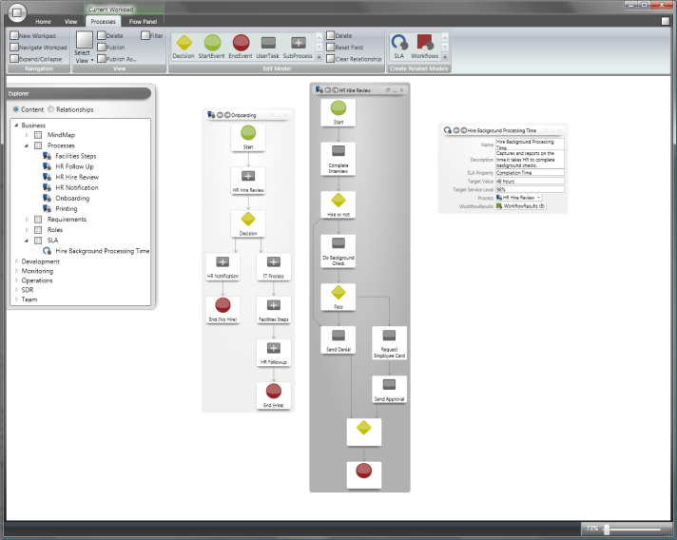
The Repository and Visual Editor
An illustration
Visual Editor
Information about applications, computers, business processes, etc.
Repository

Slide 33
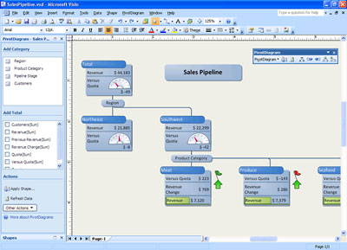
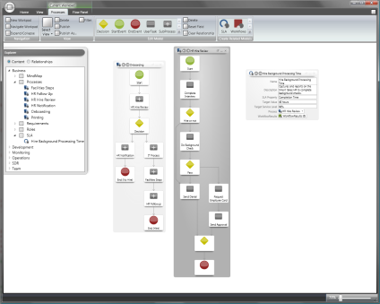
Using Other Tools
Working with the repository
Other tools can also be used to work with information in the repository
  Potential examples: Visio, Visual Studio, System Center tools, tools created by third parties
Visio
“Oslo” Visual Editor
1) Create business process description
2) Store business process description
3) Use business process description
Repository
Notes:
Third parties are also free to create tools that work with the repository. For example, an ISV that’s really good at making BA tools could build one (or extend an existing product) to work with the “Oslo” repository.

Slide 34
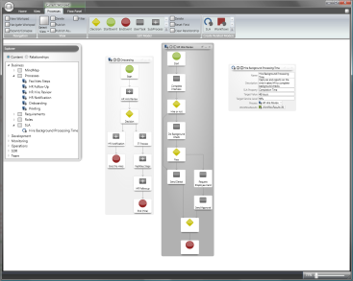
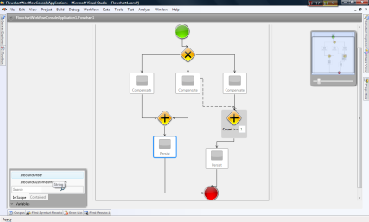


Working Together
Different tools for different roles
Business analysts and developers can work together to build WF/WCF applications
Repository
“Oslo” Visual Editor
Visual Studio
Workflow definition as repository instance
Workflow definition as XAML
Business Analyst
Developer
Notes:
This is analogous to how VS and Expression Blend work together via XAML.
A workflow’s logic can be defined solely in the XML-based XAML language
Not using a mixture of XAML and code, as it is today
A developer is more likely to use Visual Studio—it’s more familiar, the dev is probably doing things that aren’t possible in the visual editor or supported in the repository. Over time, this may change.

Slide 35
Executing Applications
WF doesn’t mandate a particular host
  WF/WCF applications can run in nearly any process
  But building a reliable, scalable host isn't simple
“Oslo” includes a new process server
  It provides a standard host for running WF/WCF apps
    Although using it isn’t required; WF/WCF apps can still run in any process
  It also supports other hosts
  It is designed to receive Deployments from the Repository
  It allows Monitoring in sync with the Model

Slide 36
The "Oslo" Process Server
Creating and running WF/WCF applications
“Oslo” Visual Editor
Visual Studio
WF/WCF Host
1) Create workflow
1) Create workflow
2) Load and run workflow
2) Load and run workflow
Repository
Filestore

Slide 37
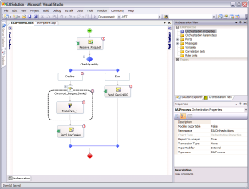
BizTalk Server
Creating applications in a future release
Lifecycle Manager
Visual Studio with Orchestration Designer
“Oslo” Visual Editor
BizTalk Host
. . .
. . .
“Oslo” Process Server
Repository
Filestore

Slide 38
Software + Services

Slide 39
Software + Services
The basics
Enterprises today primarily use software that they run themselves
  Commonly known as on-premises software
Services accessed via the Internet are becoming a more important part of enterprise IT
  Commonly known as cloud services
Enterprises are moving toward a mixed world of software + services (S+S)
  S+S = On-premises software + cloud services

Slide 40

Illustrating S+S
Service Provider
Cloud Services
Server Software
Internet
Server Software
On-premises Software
Desktop Software
Enterprise

Slide 41
Categorizing Services
A simple taxonomy
Software as a Service (SaaS)
  The application runs in the cloud
  A browser or other simple client is on-premises
Attached services
  The application runs on-premises
  Additional functions for this particular application are provided in the cloud
Cloud platforms
  The application can run either in the cloud or on-premises
  Services supporting this and similar applications are provided in the cloud

Slide 42


Categorizing Services
An illustration
Software as a Service (SaaS)
Attached Services
Cloud Platform
Application
Additional Functions
Application
Platform
Browser/ Client
Application
Application
Users
Users
Developers

Slide 43


SaaS: Another Example
Microsoft Dynamics CRM
CRM Online provides Dynamics CRM as a SaaS application
CRM Online
Dynamics CRM
Dynamics CRM as also sold as an on-premises application
  Which is much more popular today
On-premises
Dynamics CRM
Browser/ Client
Browser/ Client

Slide 44
Attached Services
Microsoft Exchange
Exchange Hosted Services provides add-on services for Exchange Server
  Such as email filtering
Exchange is also available as:
  An on-premises application (of course)
  A hosted (SaaS?) offering
Exchange Hosted Services
Exchange
Server
Outlook

Slide 45
Cloud Platform
Microsoft's Windows Live Platform
The Live Platform provides a local API to remote services that can be used by on-premises applications
  Such as mash-ups and others
Those services include:
  Virtual Earth (for maps)
  Live Search
  Data storage
  More
Live Platform
Live Platform API
Application

Slide 46
S+S and SOA
An aside
SOA and S+S aren't the same thing
  "Service" in SOA generally means a developer-accessible service
  "Service" in SaaS generally means a user-accessible service
Some connections between SOA and S+S:
  A SaaS application can expose services to on-premises applications
    Example: Salesforce.com's integration-oriented services
  A cloud platform can expose services to on-premises applications
    Example: the Windows Live Platform

Slide 47



The Microsoft Services Platform
APPLICATIONS & SOLUTIONS (FINISHED & ATTACHED SERVICES)
“Live” Services for Individuals
(no IT involvement)
“Online” Services
(IT Procured)
Third Party Apps and Solutions
BUILDING BLOCK SERVICES
IDENTITY AND ACCESS
COMMUNICATIONS
SEARCH
SERVICE DELIVERY
DATA SERVICES
BUSINESS
LOGIC
CORE SERVICES
…
GLOBAL
FOUNDATION
DATA
CENTERS
COMPUTERS
NETWORKS

Slide 48
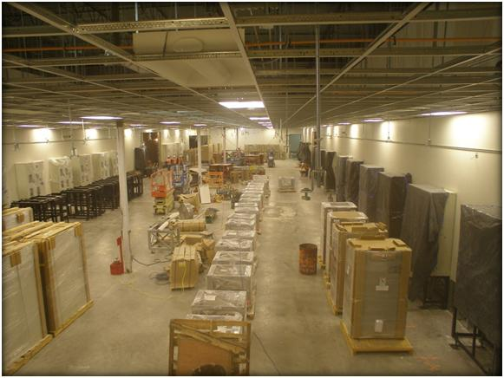

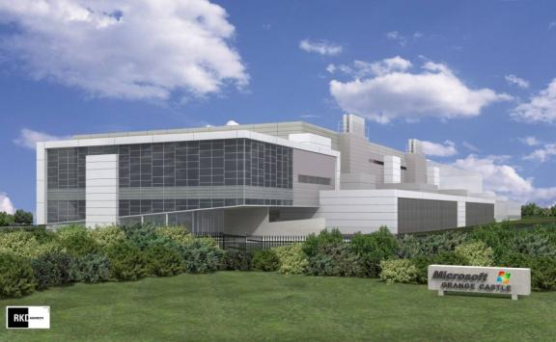
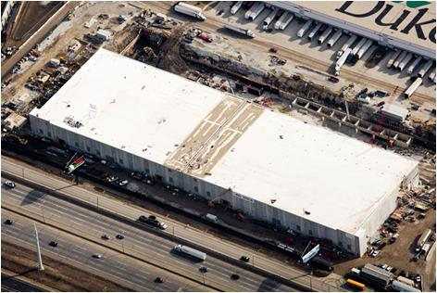
Scale Cloud Platforms
Roughly 500,000 sq.ft. each
Adding 10,000 servers/month
  “1 Facebook” of capacity
San Antonio
Quincy, WA
Dublin (Rendering)
Chicago
48

Slide 49
Microsoft Cloud Platform Strategy

Slide 50

Platforms for S+S
On-premises and in the cloud
Cloud Application
Service Provider
Cloud Platform
On-premises Application using Cloud Platform Services
On-premises
Application
Enterprise
On-premises Platform

Slide 51
Supporting Applications
What an application platform can provide
Computing
  Operating system
  Application services
Storage
  File system
  DBMS
Integration
  Connectivity, workflow, etc.

Slide 52
Supporting Applications
On-premises platform technology examples
Computing
  Operating system: Windows, Linux
  App services: .NET Framework, Java EE app server
Storage
  File system: Windows NTFS, Linux file system
  DBMS: SQL Server, Oracle
Integration
  Connectivity, workflow, etc.: BizTalk Server, WebSphere Process Server

Slide 53
Supporting Applications
Cloud platform technology examples
Computing
  Operating system: Amazon Elastic Compute Cloud (EC2)
  Application services: Salesforce.com Force.com, Microsoft Dynamics CRM platform, Google AppEngine
Storage
  File system: Amazon Simple Storage Service (S3)
  DBMS: Amazon SimpleDB, SQL Server Data Services
Integration
  Connectivity, etc.: Microsoft BizTalk Services

Slide 54
Looking Ahead: Microsoft
More to come
Plans to provide a broad cloud platform
  It will largely use standard Microsoft platform technologies
This will allow:
  Using the same developer skills and tools for creating on-premises and cloud applications
  Moving applications from the enterprise to the cloud (and back)

Slide 55
SQL Server Data Services
Structured data in the cloud
Users can create containers that contain entities
  Each entity has its own properties
  Each property has a name, type, and value
Users can query a container with operators such as ==, !=, <, >, AND, OR, NOT
Container
Entity A
Entity B
Entity C
. . .
Entity B
Name
Type
Value
Name
Type
Value
Name
Type
Value
Property 1
Property 2
Property 3

Slide 56
Microsoft’s BizTalk Services
Integration in the cloud
Provides:
  Connectivity
    In a firewall-friendly fashion
  Identity
  Workflow (soon)
Microsoft sometimes calls BizTalk Services an Internet Service Bus (ISB)
It’s not yet a commercial product (but will be!)
Currently in CTP (BizTalk Services)
Available at http://biztalk.net

Slide 57
Illustrating BizTalk Server
Integration in the enterprise
Workflow
Application
Messaging
Application
BizTalk Server
Enterprise

Slide 58
Illustrating BizTalk Services
Integration in the cloud
Service Provider
Workflow
Connectivity
Identity
BizTalk Services
Internet
Application
Application
Application
Enterprise
Enterprise

Slide 59
Technologies
BizTalk Services Gross Anatomy
Messaging (http://connect.biztalk.net)
  Applications create public addresses
  Identity provides simple access control
Identity (http://identity.biztalk.net)
  Delegate identity and access control
  Federated identity (CardSpace, ADFS)
  Username and password
Workflow (coming soon)
  Pre-defined activities, very early stage development

Slide 60

BizTalk Services
The „Components“
BizTalk Services (Hosted in the Cloud)
Messaging
Identity
Workflow
WS-* Stack
(Non-Microsoft)
BizTalk Services SDK
REST Stack
(Non-Microsoft)
User Code
User Code
User Code
* A JAVA sample currently ships in the SDK, more interop on the way

Slide 61
Quickstart – Setup
Go to http://labs.biztalk.net
Click “Create an Account”
  Enter username / password for BizTalk Services
  Associate CardSpace cards with account
Download and install BizTalk Services SDK
  WCF binding, helper classes, samples
  .NET Fx 3.0 and 3.5 compatible

Slide 62
Quickstart – Contract Creation
Build a WCF contract
  One-way, duplex, Request-reply, simple or complex data types, session settings, etc.
[ServiceContract(CallbackContract=typeof(ICallbackContract))]
interface ISomeContract {
[OperationContract(IsOneWay=true)]
void SomeOperation(String input);
} // assume SomeContract implements ISomeContract
interface ICallbackContract {
[OperationContract(IsOneWay=true)]
void CallbackOperation(String input);
} // assume SomeCallbackContract implements ICallbackContract

Slide 63
Quickstart – Host Service (Listen)
Connect to BizTalk Services as per WCF model
  Security options via IEndpointBehavior
RelayBinding rb = new RelayBinding();
CardSpaceTokenProvider csp = new CardSpaceTokenProvider();
String rootName = csp.GetUserName();
Uri address =
new Uri(“sb://connect.biztalk.net/services/justin/foo”);
ServiceHost sh = new ServiceHost(typeof(SomeContract));
ServiceEndpoint ep =
sh.AddServiceEndpoint(typeof(ISomeContract), rb, address);
ep.Behaviors.Add(csp);
sh.Open();

Slide 64
Quickstart – Connect a Client
Connect to BizTalk Services as per WCF model
  Security options via IEndpointBehavior
SomeCallbackContract cbo = new SomeCallbackContract();
DuplexChannelFactory<ISomeContract> factory =
new DuplexChannelFactory<ISomeContract>(cbo);
ISomeContract proxy = factory.CreateChannel();
proxy.SomeOperation(“Hello BizTalk Services");
Console.WriteLine("Sent message to bus");

Slide 65
Video
BizTalk Services in Action

Slide 66
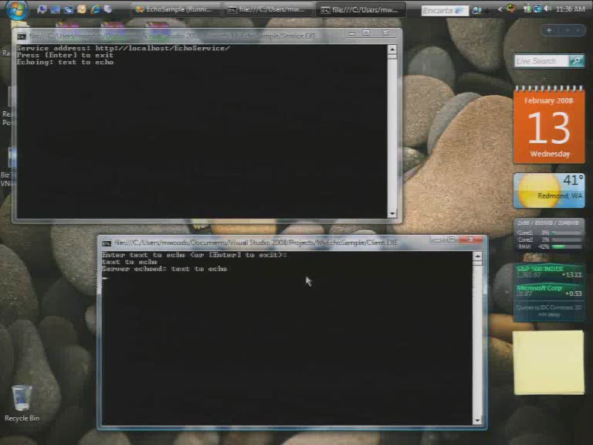

Slide 67
Technologies
BizTalk Services Functionalities
Pub / Sub via URIs
Directional Messaging via URIs
Direct Connections
Discovery
WS-Adressing
REST Support
Identity and Access Control

Slide 68
Video
Live Mesh (Part 1 – Document Sharing)

Slide 69


Slide 70
What‘s behind the „Mesh“?
Live Mesh
Experiences
Developer Tools & Services
Web Desktop
Mesh Folders
News Feeds
Mobile Mesh Clients
Etc.
Etc.
3rd party Apps
Developer
Stack
MeshFX (Protocols & APIs)
Cloud and Client MOE (Mesh Operating Environment)
Services
Platform
Identity
News
Etc.
Sync Storage
Transport
Infrastructure
Platform
Compu-tation
Storage
Core Services
Etc.

Slide 71
Video
Live Mesh (Part 2 – Remote Desktop)

Slide 72


Slide 73
Conclusion
Office Business Applications help consuming SOA
“Oslo“a group of forthcoming products and technologies is Microsoft’s answer to various challenges relating to SOA
Enterprise IT is moving to an S+S world
  This effectively means increasing enterprise use of services, e.g., SaaS applications
The next great platform battle will happen in the cloud
The change will impact everybody
  Developers, Architects, Business Analysts

