Slide 2
SQL Server 2008 数据库引擎: 产品发布十五个月后
DAT201

Slide 3
主 要 内 容
Best practices 最佳技术要领介绍
如何与SQL Server 产品部门联系，沟通
SQL Server 未来展望

Slide 4
















一: 如何通过丰富的产品功能组建最佳的解决方案!

Slide 5

寻找构建应用软件的最佳指南？
如何选择正确和合理的技术，功能并不是件容易的事
如何将SQL Server 2008功能与常规场景相结合。。

Slide 6

开启Data Compression
Row
Page
Compression white paper

Slide 7
常规指南一 ：运用“ROW” compression 针对 OLTP场景
2% - 5% CPU
20% Compression
Compression white paper

Slide 8
常规指南二：运用“PAGE” compression针对数据仓库案例
10% - 15% CPU
60% - 70% Compression
Compression white paper
Data Warehousing white paper

Slide 9
Backup compression
Backup Compression

Slide 10

运用Resource Governor来保证最佳查询
Backup
Admin Tasks
OLTP Activity
High
Admin Workload
OLTP Workload
Min Memory 10%
Max Memory 20%
Max CPU 20%
Max CPU 90%
Admin Pool
Application Pool
Resource Governor by Example

Slide 11


运用 MERGE 针对 ETL
Pre-SQL 2008
SQL 2008
UPDATE TGT
SET TGT.quantity += SRC.quantity,
TGT.LastTradeDate = SRC.TradeDate
FROM dbo.StockHolding AS TGT
JOIN dbo.StockTrading AS SRC
ON TGT.stock = SRC.stock;
INSERT INTO dbo.StockHolding (stock, lasttradedate, quantity)
SELECT stock, tradedate, quantity
FROM dbo.StockTrading AS SRC
WHERE NOT EXISTS
(SELECT * FROM dbo.StockHolding AS TGT
WHERE TGT.stock = SRC.stock);
MERGE INTO dbo.StockHolding AS TGT
USING dbo.StockTrading AS SRC
ON TGT.stock = SRC.stock
WHEN MATCHED AND (t.quantity + s.quantity = 0) THEN
DELETE
WHEN MATCHED THEN
UPDATE SET t.LastTradeDate = s.TradeDate, t.quantity += s.quantity
WHEN NOT MATCHED THEN
INSERT VALUES (s.Stock,s.TradeDate,s.Quantity)
How to use MERGE

Slide 12
可预测性能和并发性控制
运用新的表层开关来控制Lock Escalation
  ALTER TABLE
新的查询plan指南 - Plan Freezing

Slide 13


分区层的lock escalation控制
Details of lock escalation

Slide 14
运用增强的Plan Freezing机能
sp_create_plan_guide_from_handle
@name = N'MyQueryPlan',
@plan_handle = @plan_handle,
@statement_start_offset = @offset;
Understanding plan guides

Slide 15
运用增强的Plan Freezing机能
Understanding plan guides

Slide 16

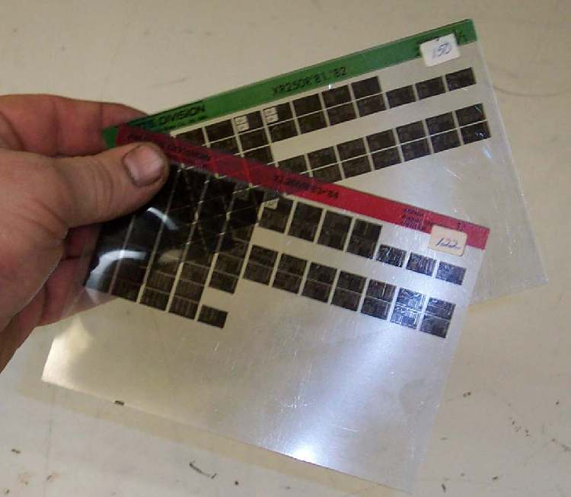
优化 SQL Server 2008 针对
特别的 workloads
sp_configure 'show advanced options', 1;
RECONFIGURE;
GO
sp_configure 'optimize for ad hoc', 1;
RECONFIGURE;
GO

Slide 17


运用Sparse Columns 来更合理
有效的利用存储空间
Optimize NULLs
White paper

Slide 18
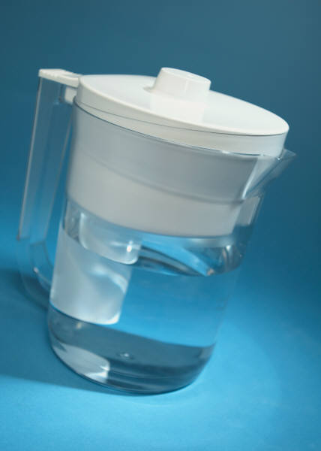
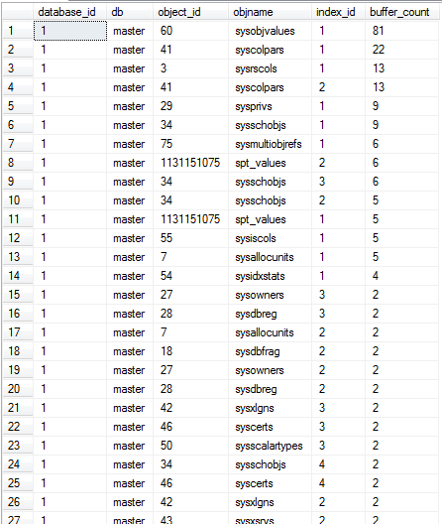


运用Filtered Indexes 来提高查询效率和灵活性
White paper

Slide 19





运用TVP 来有效的实施的大批量数据的传输
Batching
White paper

Slide 20

Some resources that will help you make informed decisions

Slide 21
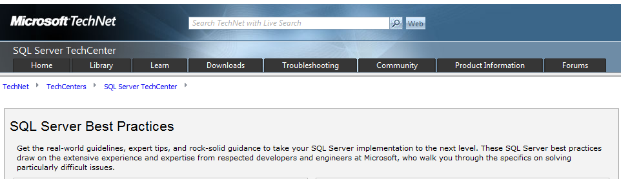
Best practices site
http://technet.microsoft.com/en-us/sqlserver/bb331794.aspx

Slide 22
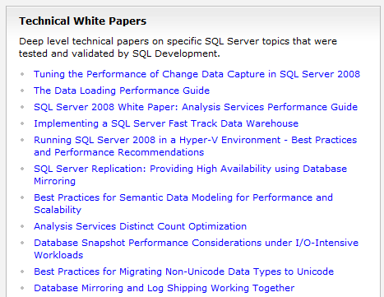
Whitepapers
More white papers at:
http://www.microsoft.com/sqlserver/2008/en/us/white-papers.aspx
http://sqlcat.com/whitepapers/default.aspx

Slide 23
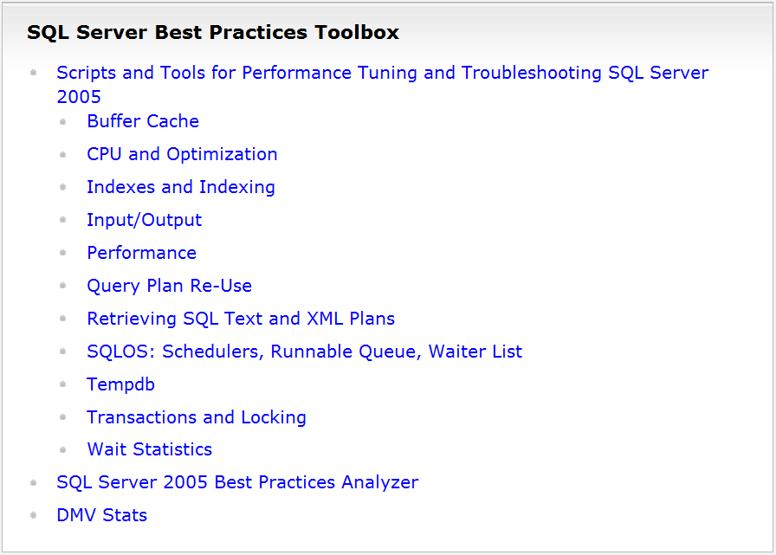

Slide 24
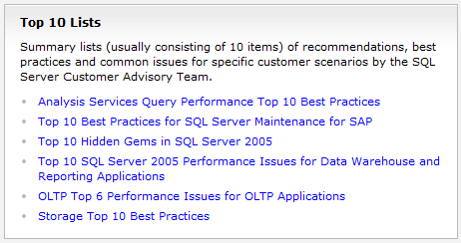
“top 10”
http://sqlcat.com is more up to date

Slide 25


二: 如何寻求帮助。。

Slide 26
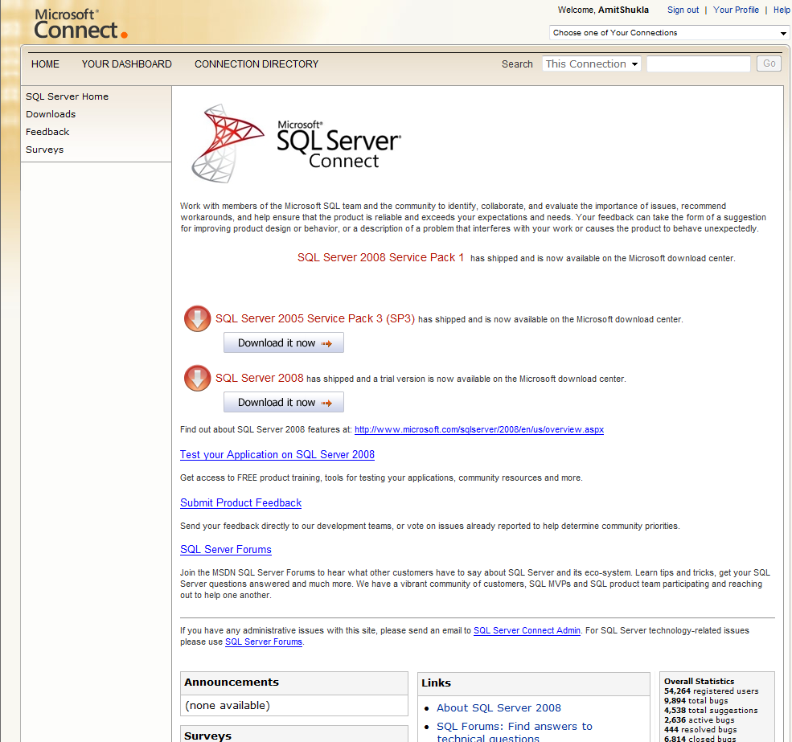

Slide 27
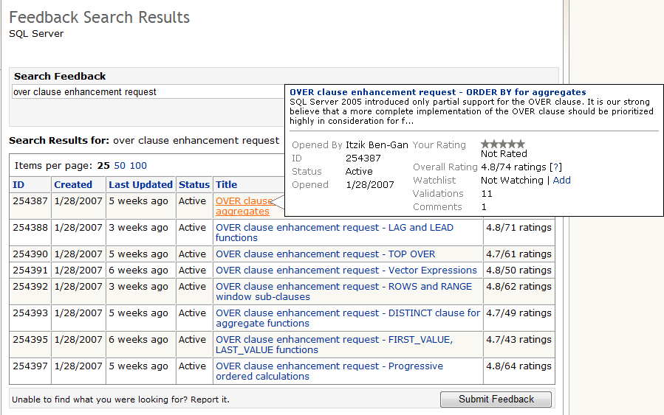
OVER clause增强功能需求

Slide 28
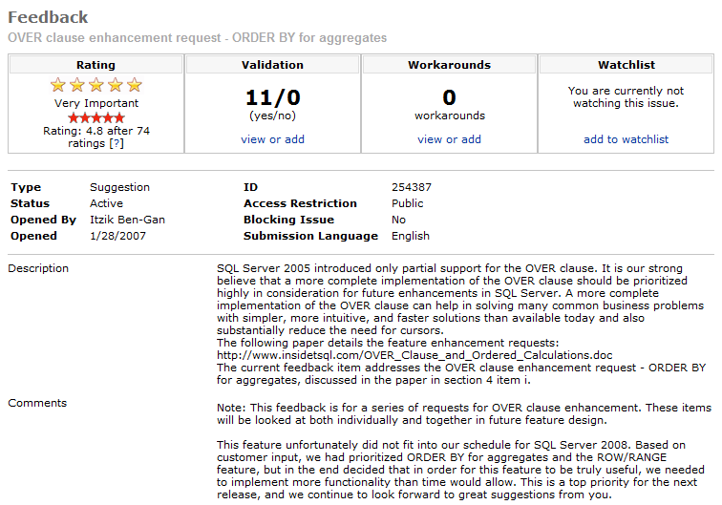

Slide 29
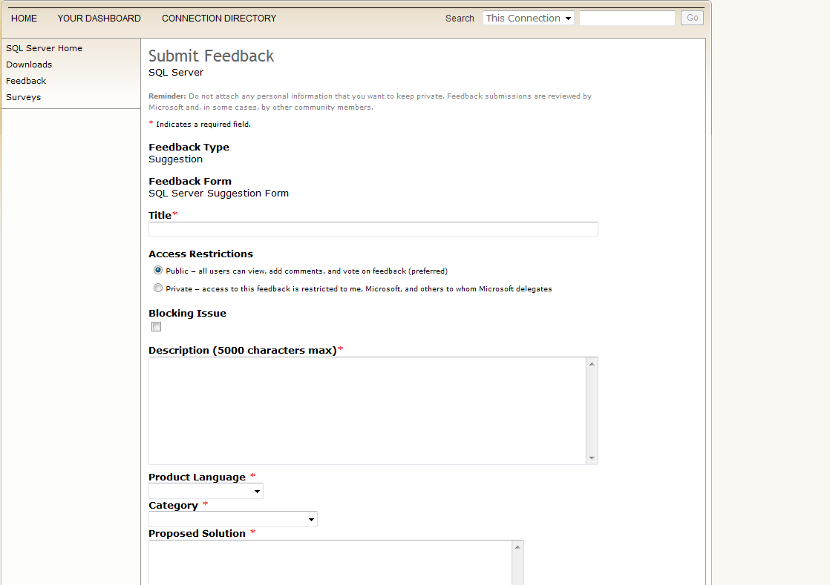
Enter a feature request

Slide 30
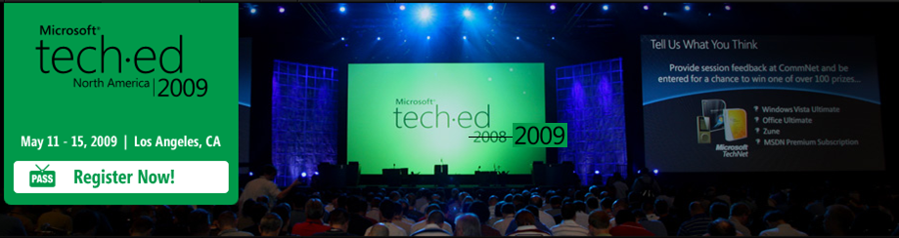
TLC at TechEd

Slide 31
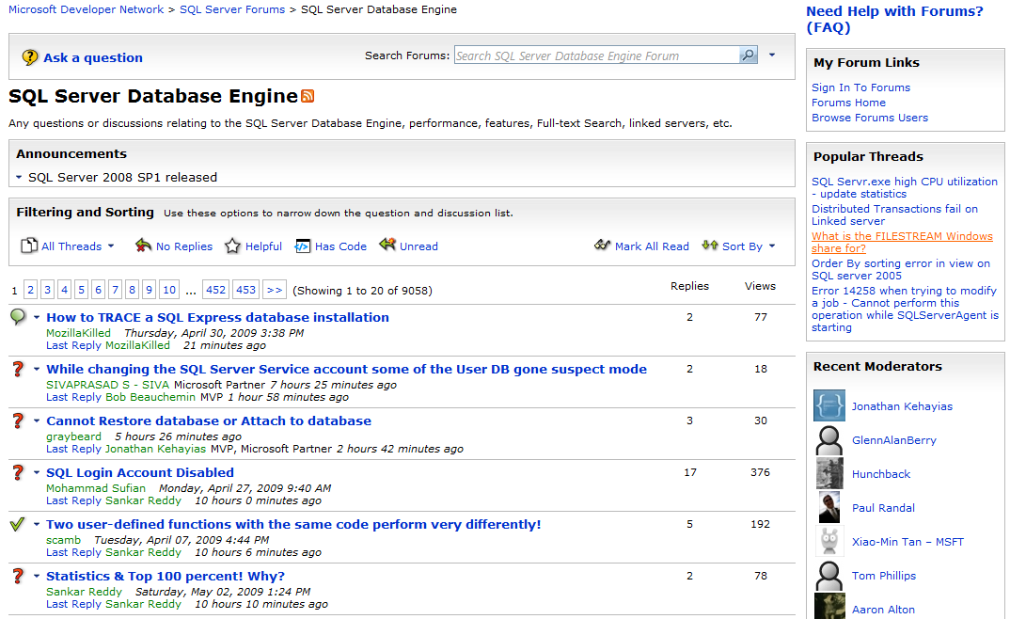
MSDN Forums

Slide 32
正规的反馈渠道

Slide 33

用户试验室

Slide 34

SDR

Slide 35

TAP program

Slide 36
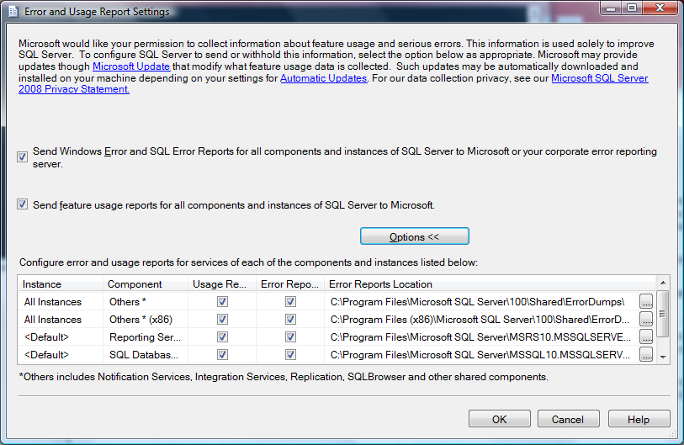
运用自动数据采集来收集用户功能运用情况，以及bugs

Slide 37
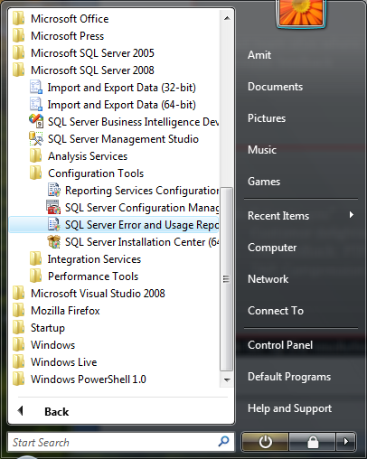
选择不记名和自动采集功能运用情况

Slide 38


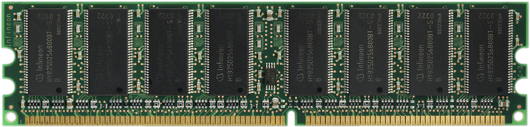
SQL Server 2008版本和硬件配置的采集

Slide 39




SQL Server 2008: 数据类型的采集
Date
Geography
Geometry
Increasing usage
Time
Sparse

Slide 40
SQL Server 2008: 数据库模块的采集

Slide 41
报告系统crashes或不可预测的错误

Slide 42



Bugs ： 自动Watson采集，和基于IP地址的汇总

Slide 43
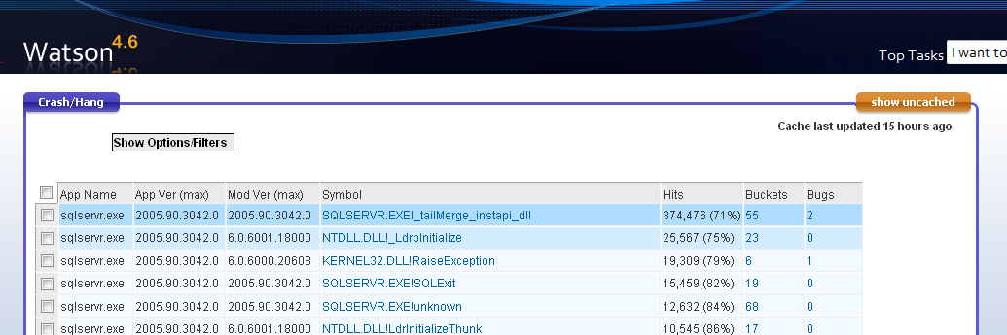
Bugs ：自动登录到产品部门的BUG数据库

Slide 44

In SQL Server 2008 we took some of your feedback to heart

Slide 45

We incorporated some developer delighters that weren’t even in the plan!

Slide 46
变量初始化
OLD
NEW
DECLARE @v INT;
SET @v = 5;
DECLARE @v INT = 5;

Slide 47
常规简易付值运算符
OLD
NEW
UPDATE Tbl
SET c1 = c1 + 5
WHERE c1 < 10;
UPDATE Tbl
SET c1 += 5
WHERE c1 < 10;
This also works for *, -, /

Slide 48
灵活简易高效的多行输入
OLD
NEW
INSERT INTO @customers (custid,name)
VALUES (1, 'cust 1');
INSERT INTO @customers (custid,name)
VALUES (2, 'cust 2');
INSERT INTO @customers (custid,name)
VALUES (3, 'cust 3');
INSERT INTO @customers (custid,name)
VALUES (4, 'cust 4');
INSERT INTO @customers (custid,name)
VALUES (5, 'cust 5');
INSERT INTO @customers (custid, name)
VALUES
(1, 'cust 1'),
(2, 'cust 2'),
(3, 'cust 3'),
(4, 'cust 4'),
(5, 'cust 5');

Slide 49
We made using a constant table super easy as well!
OLD
NEW
DECLARE @customers TABLE
(custid INT, name VARCHAR(20))
INSERT INTO @customers (custid,name)
VALUES (1, 'cust 1');
INSERT INTO @customers (custid,name)
VALUES (2, 'cust 2');
INSERT INTO @customers (custid,name)
VALUES (3, 'cust 3');
INSERT INTO @customers (custid,name)
VALUES (4, 'cust 4');
INSERT INTO @customers (custid,name)
VALUES (5, 'cust 5');
SELECT *
FROM @customers;
SELECT *
FROM (
VALUES
(1, 'cust 1'),
(2, 'cust 2'),
(3, 'cust 3'),
(4, 'cust 4'),
(5, 'cust 5')
) MyCustomers(custid, name);

Slide 50
三: SQL Server 2008 R2

Slide 51

支持256 逻辑处理器

Slide 52

支持Unicode compression
Compress

Slide 53
未来 ：同样的主题
Enterprise data platform
Dynamic development
Beyond Relational
Pervasive Insight

Slide 54




资源
Required Slide
Speakers,
TechEd 2009 is not producing
a DVD. Please announce that
attendees can access session
recordings at TechEd Online.
www.microsoft.com/teched
  Sessions On-Demand & Community
www.microsoft.com/learning
Microsoft Certification & Training Resources
http://microsoft.com/technet
  Resources for IT Professionals
http://microsoft.com/msdn
  Resources for Developers
www.microsoft.com/learning
Microsoft Certification and Training Resources

Slide 55
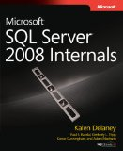
更多的资源
External Resources
  http://sqlcat.com
  http://blogs.msdn.com/sqlcat
  http://blogs.msdn.com/mssqlisv
  http://technet.microsoft.com/en-us/sqlserver/bb331794.aspx
  www.sqlserverinternals.com/books.html
SQL Server 2008 Business Value Calculator: www.moresqlserver.com

Slide 56
疑问和解答

