Slide 2
Improving Code Performance with Microsoft Visual Studio Team System
DEV313
Steve Carroll
Development Lead
Microsoft
Marc Popkin-Paine
Test Lead
Microsoft
Notes:
Intro
Set expectations
Respecting their time
Profiler’s reputation
Perf experts
And Devs who want to learn about performance
300 level, try to keep it there
Engage audience (survey)
Why?
A tool that devs can use
A tool experts can use

Slide 3
Agenda
Performance Lifecycle
Quick profiling demo
Technical deep dive
Tons of Demos of New Features Finding Regressions, Web/Load Test integration, Filtering data, Reporting, Windows Counters
Tips and tricks
Where to learn more
Notes:
Bulk is demos
Foundation excersize
Foundation for importance of performance
Foundation for the tool
Fruits of our expertise
Further your perf learning after teched

Slide 4
Performance Lifecycle
Performance measurement should be happening throughout the application lifecycle
Performance is a feature!
Gathering requirements
Maintenance
Design
Deployment
Development
Testing
Notes:
When to most people do perf
Correlation between software lifecycle and performance lifecycle
Performance is a feature
Explanation of the performance lifecycle
Tie requirements to TFS
Cheaper to catch perf here than later, plan for perf
Making sure you are close to your perf requirements before exit, perf unit tests
Verify your perf goals – web/load test, David’s session on Friday (Marc interjection)
Continuous measurement and checking for regressions

Slide 5
Don’t Leave Performance Until the End!
At its worst, you'll be faced with a memorable and sometimes job-ending quote
“This will never work. You're going to have to start all over."
—Rico Mariani, Architect, Microsoft
Notes:
1. We’ve seen this happen – performance sprinkles

Slide 6
A First Profiler Investigation
demo
Notes:
PeopleTrax
Walk through wizard
Menu location in both 2005 and 2008
Quick discussion of sampling vs. Instrumentation
Set root
Stress how easy that was
Talk about Summary view
Show calltree
Hot Path

Slide 7
Profiler 101
Tutorial

Slide 8
What Should You Measure?
Find the critical resource before designing your experiments
CPU
Disk
Memory
Network
Locking/Multithreading issues

Slide 9
Finding the Critical Resource
demo

Slide 10
Types of Profiling
Sampling
Instrumentation
Memory Allocation
Notes:
1. Tie to Critical resources!!!!!

Slide 11
Sampling: How it Works
Periodically interrupt the application
Top ->
+1 Inc
+1 Exc
+1 Inc
+1 Exc
Top ->
+1 Inc
+1 Exc
+1 Inc
+1 Exc
Bar
Bar
Bar
Top ->
Top ->
Foo
Bar
Foo
Foo
Foo
Foo
Foo
+1 Inc
+1 Inc
+1 Inc
+1 Inc
Main
+1 Inc
Main
+1 Inc
Main
+1 Inc
Main
+1 Inc
Walk the application’s stack Native Managed User Mode
Timer Page Faults System Calls CPU Performance Counters

Slide 12
Analyzing the Data
Exclusive samples
Function was on the top of the stack
Function is doing a lot of individual work
Inclusive samples
Function was on the stack (but not the top)
Function causes a lot of work to be done
+1 Inc
+1 Exc
Bar
Top ->
Foo
+1 Inc
Main
+1 Inc
Notes:
Top or on of stack
Reduce the work caused
Reduce the work done

Slide 13
Instrumentation: How it Works
Call-attributed profiling
Selects which modules (DLLs/EXEs) to instrument
Inserts probes at beginning and end of functions
Also, inserts probes before and after all calls outside the module
Probes record what function is entered plus timestamp and other performance counters
Notes:
Just say”
Select dll
Auto insertion of “measurement probes”
Record time in functions
Contrast to sampling briefly

Slide 14
Instrumentation: How it Works
int foo()
{
FUNC_ENTER(foo);
// do some work
CALL_ENTER(ExtCall);
// call a function outside this dll
ExtCall();
CALL_EXIT(ExtCall);
// do some more work
FUNC_EXIT(foo);
}

Slide 15
Application vs. Elapsed
Instrumentation measurements
Elapsed time is wall clock time
Application time is elapsed time minus an approximation of switched out time
Blocking operations
ReadFile
WaitForSingleObject
lock(this)

Slide 16
Sampling or Instrumentation?
Choose sampling when
CPU is critical resource
Low overhead is necessary
Running under load
Choose instrumentation when
Disk is critical resource
Locks are critical resource
Number of calls is important
Choose allocation profiling when
Managed memory is the critical resource
Notes:
Handy guide

Slide 17
Memory Investigations
Sampling and Instrumentation
Allocation profiling
New in Visual Studio 2008: Allocation call stacks
Can improve CPU usage as well
Fewer GCs required
Less time in allocators

Slide 18
Lifetime Profiling
Once you’ve reduced allocations, investigate managed “memory leaks”
Track deallocations in addition to allocations
Generational garbage collection
Objects that have long lifetimes tend to stay alive
Newly created objects tend to be short-lived
3 generations (0, 1, 2)
Midlife crisis
Objects that make it to Generation 2 and die

Slide 19
Allocation Profiling and Sharing What You've Learned
demo

Slide 20
Web and Load Testing
Can drive load to help you determine critical resources
Can use for regression testing
New in Visual Studio 2008: Profiling during Web and load testing
Notes:
Ask about web/load test usage
Leverage existing web/load tests that you created to track your key performance scenarios
Consistent and repeatable

Slide 21
Profiling Web Tests and Finding Regressions
demo

Slide 22
Narrowing In
demo
Notes:
Figure out how to talk about narrowing in in a compelling way

Slide 23
New Features We've Demonstrated
Hot path
Copy reports
Comparison reports
Summary reports
Profiler queries
Windows counters
Allocation callstacks
Line level sampling
Data collection control
Test integration

Slide 24
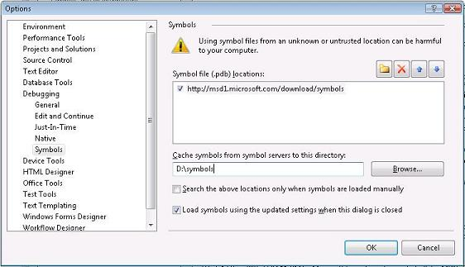
Tip #1: Microsoft Symbol Server
Crucial for context on performance issues
Set up to resolve symbols in external library code
http://msdl.microsoft.com/download/symbols
Shared with debugger settings
Tools->Options->Debugging->Symbols

Slide 25
Tip #2: Collecting on Lab Machines
Complete set of command line collection tools are available
vs_profiler.exe on the installation disk
Small footprint, fast install
Check MSDN docs for more details on command line tools

Slide 26
Tip #3: Symbol Packing
Especially important for archiving baseline for comparison reports
On by default in the UI
Tools->Options->Performance Tools to disable
From the command line
VsPerfReport /symbolpath:”<symbolpath>” /packsymbols [/debugsympath]
New in Visual Studio 2008 VSP summary files (.vsps)
Contains symbols and analyzed data

Slide 27
Tip #4: Fine Grain Control
VSPerf API
VSPerf.h, Microsoft.VisualStudio.Profiler.dll
Programmatic control of collection embedded in the application
StartProfile, StopProfile, SuspendProfile, ResumeProfile, CommentMarkProfile
Levels = global, process, thread
VSInstr
Exclude/include functions from instrumentation
Start/Stop
Programmatic control inserted automatically

Slide 28
Tip #5: Profiling Managed Services
Symptom: Function names resolve as 0x0600001
Solution: VSPerfClrEnv.cmd
From the UI, must be used with attach
Need to use global setting for profiling services
Symptom: No data collected
Use the /user flag when launching the profiling monitor
Vista: /crossSession
TechNote: Profiling Services Basics

Slide 29
Other Visual Studio 2008 Features
64-bit profiling
64-bit collection supported from command line, UI, and standalone installer
WOW64 profiling also supported
Improved CPU counter support

Slide 30
Where to Learn More
Patterns and Practices
Improving .NET Application Performance and Scalability
CodePlex: Performance Testing
Blogs
Profiler Team Blogs
http://blogs.msdn.com/ianhu/
http://blogs.msdn.com/profiler/
http://blogs.msdn.com/scarroll/
http://blogs.msdn.com/ricom
Team System Profiler Forum

Slide 31
Q&A

Slide 32
Resources
Technical Communities, Webcasts, Blogs, Chats & User Groups
http://www.microsoft.com/communities/default.mspx
Microsoft Learning and Certification
http://www.microsoft.com/learning/default.mspx
Microsoft Developer Network (MSDN) & TechNet
http://microsoft.com/msdn
http://microsoft.com/technet
Trial Software and Virtual Labs
http://www.microsoft.com/technet/downloads/trials/default.mspx

Slide 33
Resources
Monday
A Lap Around Microsoft Visual Studio 2008 (Session repeats on 6/8) 10:30
Overview of Microsoft Visual Studio 2008 for Devices and .NET Compact Framework 3.5 4:45
Tuesday
The .NET Language Integrated Query (LINQ) Framework 8:30
LINQ and XML for the Microsoft Visual Basic Developer 10:15
Building Smart Client Applications in Microsoft Visual Studio 2008 10:15
Building a Complete Web Application Using ASP.NET "Orcas" and Microsoft Visual Studio 2008 (Two parts) 10:15 and 1
Microsoft Visual C#: Tips and Tricks for the Microsoft Visual Studio 2008 IDE 1:00
Microsoft Visual Basic: Tips and Tricks for the Microsoft Visual Studio 2008 IDE 2:45
Building Microsoft Windows Presentation Foundation Applications with Microsoft Visual Studio 2008 and Microsoft Expression Blend 4:30
Wednesday
Building Microsoft Windows Communication Foundation and Windows Workflow Foundation Applications with Microsoft Visual Studio 2008 5:30
Thursday
Microsoft Visual C# Under the Covers: An In-Depth Look at C# 3.0 8:00
Writing Maintainable and Robust Application with Microsoft Visual Studio Team System 1:00
Friday
Using the .NET Language Integrated Query (LINQ) Framework with Relational Data 9:00
A Lap Around Microsoft Visual Studio 2008 (Repeated from 6/4) 1:00
What's New in Microsoft Visual Studio Team System for Testers, New Features in Visual Studio 2008 and Best Practices for Testing AJAX, SharePoint, and Reporting Services 1:00

Slide 34
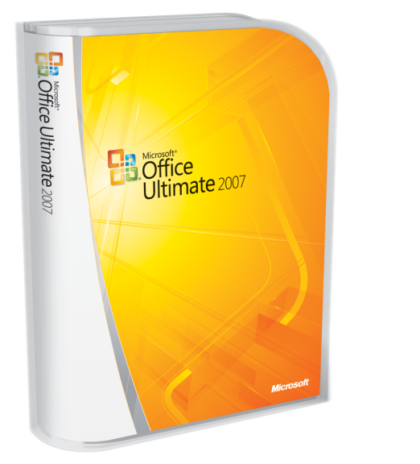
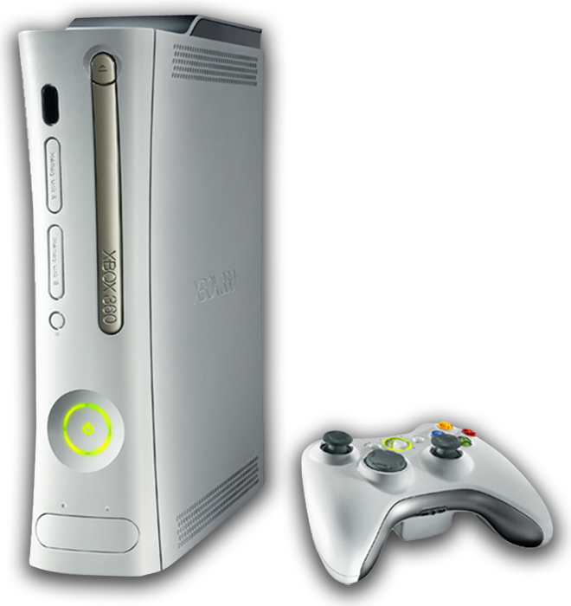
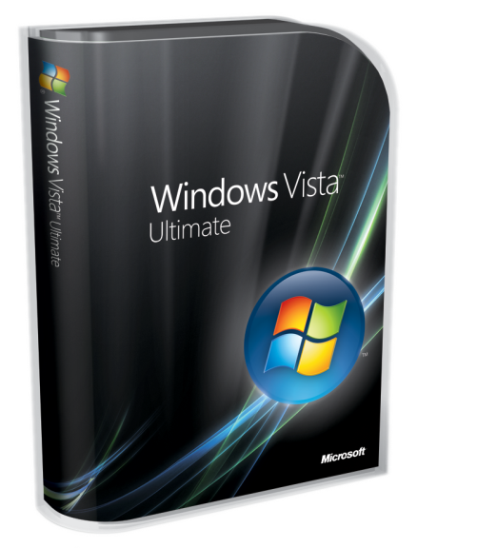
Complete an evaluation on CommNet and enter to win!

Slide 36
Supplementary Reference Slides
Tutorial

Slide 37
Finding the Performance Problem
Hot path
Calltree and Allocation reports only
Flame icon on the report toolbar
Line-level sampling
Always on
Drill down in modules view
Line/IP Views
Allocation Callstacks
Always available

Slide 38
Sharing the Performance Problem
Copy reports
Select and Copy
Pastes as html into word, outlook, and TFS work items
Summary reports
Save Analyzed Icon or context menu on the report
Store vsps files on a TFS server as baselines for comparison

Slide 39
Narrowing Down the Data
Profiler queries
Create filters automatically by using the context menu in the marks view
Filter on process, thread, time, and marks
Windows counters
All PerfMon counters available
Gathered periodically and viewed in the marks view for filtering
Data collection control
Start with collection off to ignore startup and resume later
Add/Remove marks from the list of available marks
Insert marks into the data stream

Slide 40
Regression Prevention
Test integration
Unit, web, and load test support
Drive consistent repeatable performance investigations
Accessible from test view, test results, or web/load test toolbars
Comparison reports
Find regressions using baselines in TFS or locally
Available off of the Developer->Profiler menu

