Slide 2
Integrating the Database into the Application Lifecycle Using Microsoft Visual Studio Team System for Database Professionals
DEV301
Duncan Davenport

Slide 3
Session Objectives and Agenda
Microsoft Visual Studio Team System
Visual Studio Team Edition for Database Professionals
Microsoft Solutions Framework
New Roles
Database Developer
Database Administrator
Offline Database Development
New Workstreams
DB Admin: Create a Database Project
DB Dev: Implement a Database Development Task
DB Admin: Deploy a Database Project
Process Guidance Customization

Slide 4
Visual Studio Team System
CIO
PMO
Team Edition for Database Professionals
Expand to database teams
Manage database change
Extend team productivity and collaboration
Integrated quality
Architect
Tester
Developer
DB Pro
Project Manager
Designer
Business
Analyst
Application
Support
Operations
4
Notes:
4
6/8/2007 7:42 AM
4
© 2005 Microsoft Corporation. All rights reserved.
This presentation is for informational purposes only. Microsoft makes no warranties, express or implied, in this summary.

Slide 5
Incorporate the Database Professional into the software lifecycle and provide them with a foundation for change management and process integration.
Change Management
Project-Based Development
Project Model that represents schema as objects providing a “personal sandbox” for offline development that lives within a Visual Studio Solution
Team Collaboration with Work Item and Process Integration with Team Foundation Server
Automated Change Support
Rename Refactoring with the ability to preview pending changes prior to execution
Comparison Tools (Schema & Data Compare) allow comparisons & synchronization of schema and data with design/test/production databases
Version Control of all database objects with the ability to reverse engineer a database to bring it under Source Control
Database Unit Testing
Database Unit Testing ensures iterative changes don’t break existing functionality
Data Generator provides Repetitive Dataset Generation for tests based on saved settings
Build / Deployment
MSBuild Integration for Database Deployments/Builds based on Projects
Either Create a new Database at the target location or Update an Existing Schema
5
Notes:
5
5

Slide 6
Microsoft Solutions Framework (MSF)
A highly customizable, scalable, fully integrated set of software development processes, principles, and proven practices
Designed to deliver the type of guidance desired by the user when and where it is needed
Seamless experience with Visual Studio 2005 Team System for process automation and guidance

Slide 7
Process Guidance Templates
Components
Prescriptive Guidance
Roles
Workstreams
Activities
Work products
Process Enactment
Work items
Queries
Reports
Check-in policies

Slide 8
Process Guidance Templates
MSF Agile/MSF for CMMI
MSF Agile
MSF for Agile Software Development is a scenario-driven, context-based, agile software development process that utilizes many of the ideas embodied in Visual Studio Team System
9 roles, 17 workstreams, 5 work item types
MSF for CMMI
MSF for CMMI Process Improvement provides rich connections to the CMMI process to help organizations quickly implement mature software development practices
20 roles, 26 workstreams, 7 work item types

Slide 9
WorkItems and WorkFlow
Bugs
Quality of
Service Reqs
Test
Scenarios
Tasks
Business
Analyst
Dev Team
Change
Requests
Project
Manager
Production
Errors
Work Items are the units of communications within the
development team
Operations

Slide 10
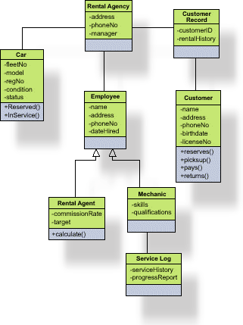
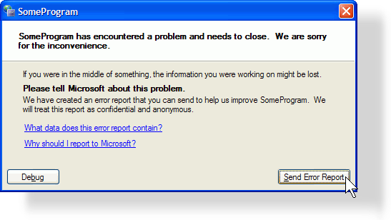
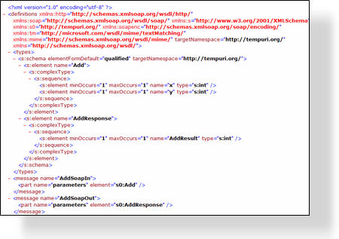
What is in a Work Item?
Proposed
Title
Description
Current State
Active
Active
Attachments
Scenario
Tasks
Bugs
Resolved
Who it is assigned to
Resolved
Links to other Work Items
Full Auditable history
Closed
Closed
Anything else you want …

Slide 11
MSF Agile: Team Model
Project Manager
Architect
Program Management
Archtecture
Business
Analyst
Developer
Product Management
Development
Team of Peers
Database Developer
User Experience
Test
Business Analyst
Tester
Release Operations
Database Administrator
Release Manager

Slide 12
New Roles
Database Developer
Implement all database development tasks within the planned time frame
Cost estimation, supervision of feature implementation, and providing database expertise to the other developers on the team
Participates in the iterative database development lifecycle, along with the database administrator and the application development team members
Database Administrator
For database development, support the…
Creation of database projects
Deployment of database project changes to production
In addition to the database administrator’s traditional role of performing day-to-day administration and maintenance of database servers

Slide 13
New Work Streams
Create a Database Project
Implement a Database Development Task
Deploy a Database Project

Slide 14
MSF Agile: Exploring the Process Guidance
demo

Slide 15
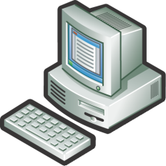
Conceptual Overview
Production Database
Management Studio
Difficult to manage change to the schema
Production database is “one version of the truth” for data and schema”
DBA doesn’t have access to changes until he/she has deploy or reject choice
Changes often made to production database and not rolled back into test
Tuning
Monitoring
Schema Changes
Schema
“One Version of the Truth” for Data and Schema
15
Notes:
15

Slide 16
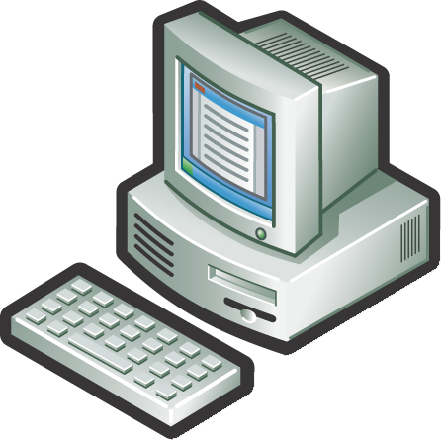
Conceptual Overview
Production Database
Management Studio
Schema change now managed in Visual Studio Team System and Team Foundation Server
Production Database is now “one version of the truth” only for data
DBA does have access to changes before he/she has deploy or reject choice
“One version of the truth” for schema is under source control
Tuning
Monitoring
“One Version of the Truth” for Data
“One Version of the Truth” for Schema
Changes can be rolled out in a scheduled & managed way
Scripts allow administrators to manage change updates
Offline
Under Source Control
Schema
Schema Changes
16
Notes:
16

Slide 17
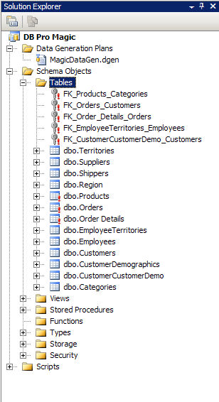
Offline Development
Production Database
Create table AUCTION
( id int not null,
title varchar(25) not null,
startDate DateTime not null,
length in not null)
Test Database

Slide 18
Create a Database Project
Key activities
Create Database Project
Import Existing Database
Configure Build & Deploy Settings
Modify Generated Pre\Post Deployment Scripts
Verify Database Project
Add Database Project to Source Control

Slide 19
Create a Database Project
Database Administrator
SCM
Check in to Source Control
DB Dev
DB Admin
Database
Project
Production
Database
Import schema

Slide 20
Create a Database Project
Database Project Wizard
Microsoft SQL Server 2000 & SQL Server 2005 Database Project Wizards
Guide you through the entire database project creation workstream
Ease initial project setup

Slide 21
DBAdmin: Create a Database Project
demo

Slide 22
Implement a Database Development Task
Key activities
Cost a Database Development Task
Update Local Project Environment
Build \ Deploy to local sandbox server
Write Code for a Database Development Task
Build \ Deploy…
Perform a Database Unit Test
Refactor Database Code
Build \ Deploy \ Run tests…
Review Database Code
Build \ Deploy \ Run tests…
Integrate Database Code Changes
Build \ Deploy \ Run tests…

Slide 23
Isolated Iterative Development
Sync
Check-out
Edit/Refactor
Test
Check-in
Sand box
Sand box
SCM
Work is being driven and tracked via work items
Sand box
Sand box
DB Dev
DB Admin
Production
Database

Slide 24
DB Dev: Implement a DB Development Task
demo

Slide 25
Deploy a Database Project
Key activities
Synchronize Database Project
Verify Build
Perform Database Unit Tests
Analyze Changes
Create Build Script
Back Up Target Database
Deploy Database to Staging Server (Optional)
Deploy Database

Slide 26
Conceptual Overview
SCM
Sync from Label
DBDev
DBA
Verify
Staging
Database
Build
SQL
Deploy
Script
Refine deploy script
Database
Project
Deploy
Production
Database

Slide 27
DBAdmin: Deploy a Database Project
demo

Slide 28
Process Guidance Customization
Prescriptive Guidance
Extend or create new process guidance
Customize Process Guidance for a specific methodology
MSF Agile, MSF for CMMI
Scrum
SOX, ISO9000, PRINCE2
Iterative Agile DB Development
Customize roles, workstreams, activities, work products
Download Process Guidance Template from http://msdn.microsoft.com/msf
Many partners have built templates already
Notes:
6/8/2007 7:42 AM
28
©2005 Microsoft Corporation. All rights reserved.
This presentation is for informational purposes only. Microsoft makes no warranties, express or implied, in this summary.

Slide 29
Process Guidance Customization
Prescriptive Guidance
Download Process Guidance From MSF
Modify Process Guidance using InfoPath
Compile Process Guidance with MSFWinBuild
Upload new Process Guidance to Team Server
Notes:
6/8/2007 7:42 AM
29
©2005 Microsoft Corporation. All rights reserved.
This presentation is for informational purposes only. Microsoft makes no warranties, express or implied, in this summary.

Slide 30
Process Template Customization
Work Items \ Queries \ Reports
Process Template can be downloaded from MSF site, or downloaded from Team Foundation Server
Work Items
Introduce new work items types or add database-specific fields into existing work items types
Queries
Generate specific queries for database professionals utilizing new work items \ fields
Reports
Generate trend reports useful for database professionals
Notes:
6/8/2007 7:42 AM
30
©2005 Microsoft Corporation. All rights reserved.
This presentation is for informational purposes only. Microsoft makes no warranties, express or implied, in this summary.

Slide 31
Process Template Customization
Work Items \ Queries \ Reports
Download Process Template from MSF
Download Process Template from Team Server
Modify Process Template with XML Editor
Modify Process Template with Team System Process Editor
Upload changes to Team Server
Notes:
6/8/2007 7:42 AM
31
©2005 Microsoft Corporation. All rights reserved.
This presentation is for informational purposes only. Microsoft makes no warranties, express or implied, in this summary.

Slide 32
Database Development Lifecycle
Wrap-up
Database development lifecycle is enabled through
Enhanced database development tools
Visual Studio Team Edition for Database Professionals
Improved process guidance incorporating the database professional
Updated MSF Agile \ CMMI Process Guidance Templates
Isolated offline database development is the key enabler of iterative development and risk mitigation

Slide 33
Availability
MSF Process Guidance \ Visual Studio Team System Database Edition
MSF Process Guidance
Process Templates ship with Visual Studio Team Foundation Server
Updated process guidance – Web download
Visual Studio Team System Database Edition
Download and Add to VSTS 2005
Included in Visual Studio 2008 Team Suite
33
Notes:
33

Slide 34
Related Content
DAT317 Database Schema Versioning: How to Use Microsoft Visual Studio Team System for Database Professionals and Team Foundation Server to Version and Deploy Your Databases
Monday, June 4 10:30 AM - 11:45 AM, S310 E
DEV301 Integrating the Database into the Application Lifecycle Using Microsoft Visual Studio Team System for Database Professionals
Friday, June 8 2:45 PM - 4:00 PM, S210 E
DEV04-HOL – Getting Started with Microsoft Visual Studio Team Edition for Database Professionals
DEV05-HOL – Integrating the Software Development Lifecycle with Microsoft Visual Studio Team Edition for Database Professionals
DEV06-HOL – Comparing Database Schemas and Deploying Changes with Microsoft Visual Studio Team Edition for Database Professionals
DEV07-HOL – Managing Change with Microsoft Visual Studio Team Edition for Database Professionals
Notes:
6/8/2007 7:42 AM
© 2005 Microsoft Corporation. All rights reserved.
This presentation is for informational purposes only. Microsoft makes no warranties, express or implied, in this summary.
34

Slide 35
Resources
Product Website
http://msdn.microsoft.com/vstudio/teamsystem/products/dbpro/default.aspx
Microsoft Solutions Framework
http://www.microsoft.com/msf
Team Foundation Server Power Tools
http://go.microsoft.com/?linkid=542249
Product MSDN Forums http://forums.microsoft.com/MSDN/ShowForum.aspx?ForumID=725&SiteID=1
Blogs
http://blogs.msdn.com/gertd
http:// blogs.msdn.com/duncand

Slide 36
Resources
Technical Communities, Webcasts, Blogs, Chats & User Groups
http://www.microsoft.com/communities/default.mspx
Microsoft Learning and Certification
http://www.microsoft.com/learning/default.mspx
Microsoft Developer Network (MSDN) & TechNet
http://microsoft.com/msdn
http://microsoft.com/technet
Trial Software and Virtual Labs
http://www.microsoft.com/technet/downloads/trials/default.mspx

Slide 37
Q&A

Slide 38
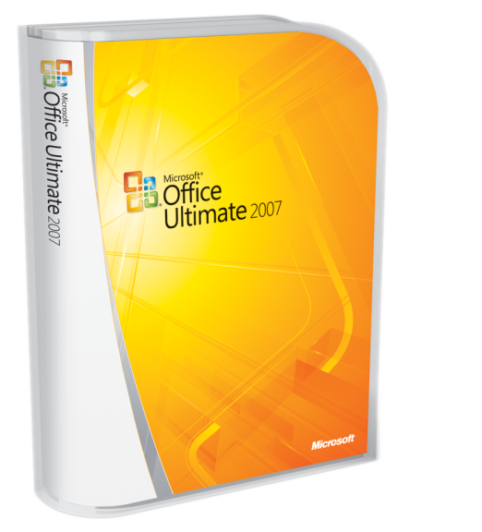
Complete an evaluation on CommNet and enter to win!

Slide 39
Resources
Monday
A Lap Around Microsoft Visual Studio 2008 (Session repeats on 6/8) 10:30
Overview of Microsoft Visual Studio 2008 for Devices and .NET Compact Framework 3.5 4:45
Tuesday
The .NET Language Integrated Query (LINQ) Framework 8:30
LINQ and XML for the Microsoft Visual Basic Developer 10:15
Building Smart Client Applications in Microsoft Visual Studio 2008 10:15
Building a Complete Web Application Using ASP.NET "Orcas" and Microsoft Visual Studio 2008 (Two parts) 10:15 and 1
Microsoft Visual C#: Tips and Tricks for the Microsoft Visual Studio 2008 IDE 1:00
Microsoft Visual Basic: Tips and Tricks for the Microsoft Visual Studio 2008 IDE 2:45
Building Microsoft Windows Presentation Foundation Applications with Microsoft Visual Studio 2008 and Microsoft Expression Blend 4:30
Wednesday
Building Microsoft Windows Communication Foundation and Windows Workflow Foundation Applications with Microsoft Visual Studio 2008 5:30
Thursday
Microsoft Visual C# Under the Covers: An In-Depth Look at C# 3.0 8:00
Friday
Using the .NET Language Integrated Query (LINQ) Framework with Relational Data 9:00
A Lap Around Microsoft Visual Studio 2008 (Repeated from 6/4) 1:00
What's New in Microsoft Visual Studio Team System for Testers, New Features in Visual Studio 2008 and Best Practices for Testing AJAX, SharePoint, and Reporting Services 1:00

Slide 40
Resources
Monday:
A Lap Around Silverlight 4:45
Thursday:
Enhancing ASP.NET AJAX Applications with Silverlight 8:00
Silverlight Tips and Tricks 4:30
Friday:
Creating and Delivering Rich Media and Video on the Web with Silverlight, Expression Studio, and Windows Server 2008 9:00
Building Rich Internet Applications with Silverlight 1:00
Building Interactive Media Experiences with Silverlight 2:45
Links:
Scott Guthrie on Channel 9 - http://channel9.msdn.com/showpost.aspx?postid=304508
Silverlight Developer Center - http://msdn2.microsoft.com/en-us/silverlight/default.aspx
Silverlight Alpha 1.1 SDK - http://msdn.microsoft.com/vstudio/eula.aspx?id=c8bf88e7-841c-43fd-c63d-379943617f36

