Slide 2
Microsoft Solutions Framework 4.0 Core and its Families
DEV210
Rafal Lukawiecki
Strategic Consultant
Project Botticelli Ltd
rafal@projectbotticelli.co.uk

Slide 3

Objectives
Convince you that non-technical reasons impact project success a lot
Show you an approach to solution delivery that has proven to be very successful
This presentation is partly based on various MSF MOC course materials (old and new), the book and a presentation by Mike Turner (see later), and comments and feedback from many Microsoft people and other nice people, including, with special thanks: Randy Miller and Clementino Mendonca. Thank you!
The information herein is for informational purposes only and represents the opinions and views of Project Botticelli and/or Rafal Lukawiecki. The material presented is not certain and may vary based on several factors. Microsoft makes no warranties, express, implied or statutory, as to the information in this presentation.
© 2007 Project Botticelli Ltd & Microsoft Corp. Some slides contain quotations from copyrighted materials by other authors, as individually attributed. All rights reserved. Microsoft, Windows, Windows Vista and other product names are or may be registered trademarks and/or trademarks in the U.S. and/or other countries. The information herein is for informational purposes only and represents the current view of Project Botticelli Ltd as of the date of this presentation. Because Project Botticelli & Microsoft must respond to changing market conditions, it should not be interpreted to be a commitment on the part of Microsoft, and Microsoft and Project Botticelli cannot guarantee the accuracy of any information provided after the date of this presentation. Project Botticelli makes no warranties, express, implied or statutory, as to the information in this presentation. E&OE.

Slide 4
Agenda
Introduction to Frameworks
The MSF 4.0 Families
  Brief Look at Software Development Family
Components of MSF 4.0 Core
Relationship with VSTS+TFS
Conclusions

Slide 5

Introduction to Frameworks

Slide 6
MSF
Microsoft Solutions Framework
  Established in 1991, made public in 1993 (v1), fully revised in 1998 (v2), January 2003 (v3), March 2006 (v4), with v4 Core formally made public October 2006
  Solution delivery framework for creating software, deploying infrastructural solutions, and consulting
Related to MOF, Microsoft Operations Framework
  Which concentrates on the management of
  IT infrastructure
  MOF may become part of MSF in the future

Slide 7

IT Lifecycle
Microsoft Solutions Framework
Plan
Operate
Build
Deploy
Microsoft Operations Framework

Slide 8
Solutions Delivery: Easy Success?
Failed
Challenged
Succeeded
2003
15%
51%
34%
2000
23%
49%
28%
1998
28%
46%
26%
1995
40%
33%
27%
1994
31%
53%
16%
This chart depicts the outcome of the 30,000 application projects in large, medium,
and small cross-industry U.S. companies tested by The Standish Group since 1994.
Source: The Standish Group International, “10th Annual (2003) CHAOS Report,” CHAOS
Chronicles 3 (2003): 406.

Slide 9
What’s a Framework?
Unlike a methodology, a framework is a set of conceptual tools and best practices
In v4 of MSF we see both frameworks and methodologies in action
  The word “framework” may no longer be accurate
  (see later)

Slide 10
Root Causes of Failure
Separation of goal and function
Separation of business
and technology
Lack of common language
and process
Failure to communicate and
act as a team
Processes that are inflexible
to change
Solution?
  A good and tested framework!
“When projects fail, it’s rarely technical.”
Jim Johnson, The Standish Group
Average cost overrun:
45%
Time overrun:
63%
Functionality delivered on average:
67%
Standish Group

Slide 11
MSF 4.0 Families

Slide 12





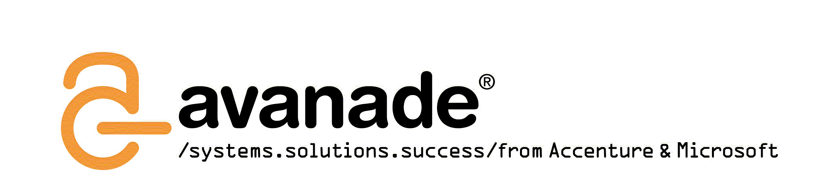








MSF Partner Council Who Advised v4

Slide 13
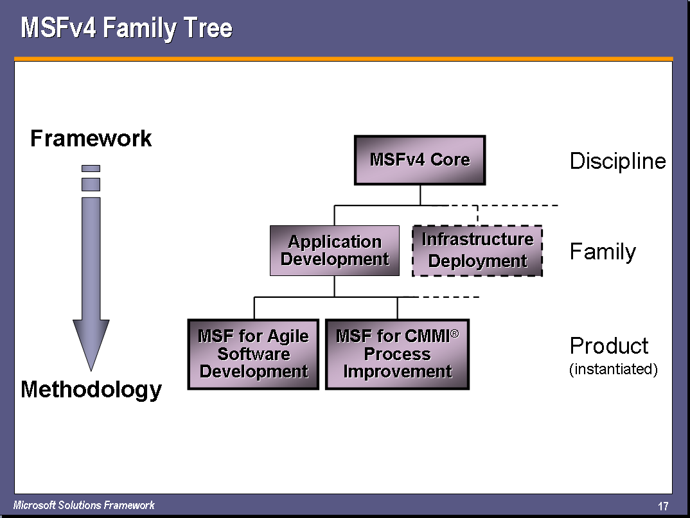
Framework or Methodology?

Slide 14
Status – The Released Stuff
MSF v3 has been officially retired
  Course MOC #1846 has been retired too – new course is being finalised (Release Candidate stage)
MSF v4 Core has been released
  Reference book “Microsoft Solutions Framework Essentials”
  by Mike Turner
  New course MSF v4 Essentials is in RC stage
MSF v4 for Application Development (both Agile and CMMI)
have shipped in March 2006
  Download guidance from www.microsoft.com/msf
  Many non-MSF (but often compatible) process templates are available
  from the same web location – SCRUM, PMPoint, FDD, Macroscope, EssUP, and TeamGuide as of June 2007

Slide 15
The Stuff Still to Come
While Microsoft Patterns & Practices group concentrates on MSF Software Development family, Microsoft Consulting Services
are working on:
  MSF v4 for Infrastructure Deployment
    Under development at present (early days)
  MSF v4 for Operations Management
    Under consideration as a complement or successor to MOF
  Microsoft-internal flavours of MSF are also in
  intensive development

Slide 16
Family Relations
MSFv4 “Core”
Discipline
Application Development
Infrastructure
Deployment
Family
MSF for Agile Software Development
MSF for CMMI® Process Improvement
Product
MSF v4
CMMI
Infrastructure
Deployment
Agile
MSF v3

Slide 17
Software Development Family

Slide 18
Agility
Agility of the development process is a key tool to deal with inevitable changes (spec, environment, business) or planning errors
The price of it is some unpredictability
  Finish date, final cost, feature set…
Generally, agility is great for small and medium projects in existing and tested dev environments

Slide 19
CMMI
Capability-Maturity Model Integration describes 5 (or 6) levels of process-based predictability of an organisation
in terms of ability to produce quality software
Level 5 is best. Most companies are 0 or 1. MSF v4 can help you work at level 3 or more.
Moving up by adopting predictable
(but not so agile) processes
Great for larger or more formal projects
  Especially in more critical environments
By the way, MSF and CMMI are not strangers: KPMG published a paper on how MSF v1 could help you with CMM already in 1995!

Slide 20
What About Extreme Programming (XP)?
Extreme Programming (XP) came after MSF and
has some similarities:
  Zero Defect Mindset and Daily Builds from MSF v3 in particular
XP is less predictable than necessary for more
formal projects
  But great for very agile projects
MSF for Agile Software Development seems more predictable, controllable and even more agile than XP
MSF CMMI Process Improvement, naturally, is less agile than XP, but seems the most predictable

Slide 21
Key Components of MSF 4.0 Core

Slide 22
MSF Team Model (Core Level)
Advocates, Ambassadors & Representatives
Solution Delivery
Solution Design
Program
Management
Architecture
Solution Construction
Solution Verification
Solution Definition
Product
Management
Development
Advocacy
User
Experience
Test
Solution Usability
User Readiness
Release
Operations
Solution Validation
Solution Deployment

Slide 23

Scaling the Team Model for Larger Projects
Lead team
Function team
Program
Management
Architecture
Product
Management
Development
User
Experience
User
Experience
Test
Program
Management
Release
Operations
Program
Management
Architecture
Development
Architecture
Development
Catalog
Fulfillment
User
Experience
Test
Test
Program
Management
Release
Operations
Architecture
Development
Site Engine & Design
User
Experience
Test
Feature teams

Slide 24
Process Modelling in 4.0
MSF v4 introduces a new model of Governance and Enactment which replace the traditional process model
This caters for different types of processes
  Defined at the level of methodology
  Governance at the framework level
Side-effect: MSF now works well for
very small teams too
  V3 was for medium or larger projects only

Slide 25
MSF 4.0 Governance
Governance
Enactment

Slide 26
Tracks in MSF v4
Deploy
Envision
Stabilize
Build
Plan

Slide 27
Continuous Improvement As
Tracks Progress
Knowledge
Deploy
Reduced Risk
Solution Completion
Stabilize
Build
Plan
Envision
Time

Slide 28
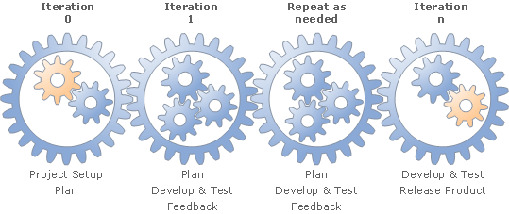
Iterations
Achievement of a pre-determined level of quality
Based on planning of feature-sets
Mechanism to correct project plan deviations

Slide 29
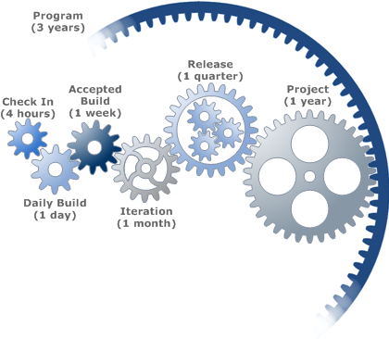
Elements of an Iterative Approach
Each cog represents a “measure of work”

Slide 30
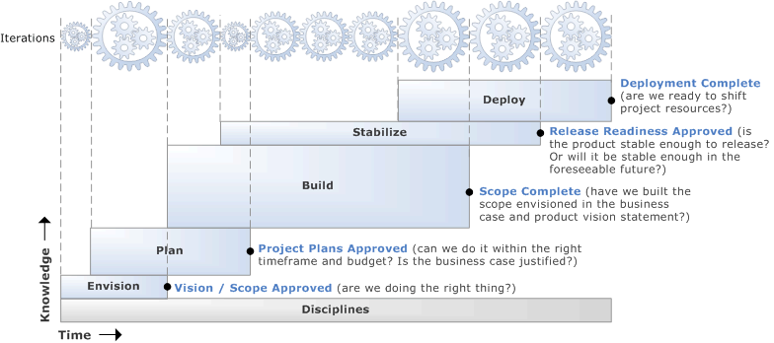
Example: MSF 4 for CMMI
Process Improvement
Specific enactment of the governance model
Maps processes to iterations

Slide 31

Daily (Nightly) Build
At the Heart of an Iteration
Building the product in
a deployable form on a
daily basis
A daily build is
  A strong indicator that a team is functional
  Guarantee against component integration problems
  A way to make the product and its progress visible
  The heartbeat of the development process
A key function of VSTF (see later)

Slide 32
How Does Daily Build Work?
A
  A → A’
  B
  C
B
  A
  B → B’
  C
C
  A
  B
  C → C’
A
  A’
  B
  C’
B
  A’
  B, B’
  C’
C
  A’
  B
  C’
A’’
  From A’
B’’
  From B and B’
C’’
  From C’
→
Day 1
→
BVT
→
Day 2
→
BVT
→
Day 3

Slide 33
Continuous Integration
Why stop at nightly builds?
Build after every code check-in, if you wish
  Team Foundation Server supports this concept as Continuous Integration
Requires some discipline
BVT cannot be too extensive without
a larger test farm

Slide 34
Note on Designing Software within MSF
MSF 4.0 Core leaves freedom to chose
a design method
  UML (Unified Modelling Language) has a great tradition but is not service-oriented
    UML2? Perhaps.
  Domain Specific Languages
    Great conceptual integration both with MSF and with the tools (VSTS)
    Further, possible, integration with SDM and DSI
  Software Factories
    Deliver tested Patterns and Practices

Slide 35
Kano: Managing Requirements to Iterations
Customer Satisfaction
Minimum Acceptance Level
Delighters
Misses Expectations
Iteration #3
Meets Expectations
Iteration #2
Iteration #1
Dissatisfiers
Customer Dissatisfaction

Slide 36
Project Management in 4.0
At Core discipline level, MSF recommends PMI (Project Management Institute) BOK
(Body of Knowledge)
  Cross-industry standard
At methodology-level, it becomes more exciting
  MSF for Agile SD and for CMMI PI introduce an ingenious mechanism of activities and work streams – see later

Slide 37
What Did I Leave Out?
Risk Management
  Prepares you for the unpredictable
Readiness Management
  New support for steering/encouraging/entrusting
  team members
Analysing Stakeholders
  New way of mapping approaches for managing them
A few smaller bits from Core
Many major parts of Software
Development Family

Slide 38
Relationship with VSTS+TFS

Slide 39
Work Items
Activities and Workstreams manage the concept of a work item, which describes an assignable, individual piece of effort that needs to be done:
  Bug
  Quality of Service Requirement
  Scenario
  Risk
  Task

Slide 40
Team System with Foundation Server
Ingenious: tool that implements MSF
VS 2005 TFS manages the flow of work items between team members and monitors their progress
Team Suite or individual versions for
  Software Developers
  Software Architects
  Database Professionals
  Software Testers
Reporting and management tools for project manager and other team members
  Includes Outlook, Excel and Project Support

Slide 41
VSTS Process Metamodel
Role
performs
Work Stream
Iteration
permissions
sequences
schedules
Security Group
Activity
produces & consumes
Work Product
belongs to
tracks
User
owns
Work Item
schedules
Iteration
groups
reports
Query
Key:
Report
Process Guidance Prescribes
VSTS Enacts

Slide 42
Conclusions

Slide 43
Resources
Naturally, www.microsoft.com/msf
    Redirects to VSTS Process Guidance
    No MSF 4.0 Core site yet
Books
    “Microsoft Solutions Framework Essentials”, Michael S. V. Turner, Microsoft Press 2006, ISBN 0-7356-2353-8
    “Software Engineering with Microsoft Visual Studio Team System”, Sam Guckenheimer, Addison-Wesley Professional 2006, ISBN 0-3212-7872-0
  An active, mature MSF forum at forums.microsoft.com/msdn/ShowForum.aspx?ForumID=63
  MOF still at www.microsoft.com/mof

Slide 44
Summary
Projects fail for non-technical reasons
A framework such as MSF fixes those problem
Chose the MSF methodology best suited
for your project
Visual Studio Team System implements
MSF for you, and
VSTS also supports many other forms of
Process Guidance

Slide 45
Resources
Technical Communities, Webcasts, Blogs, Chats & User Groups
http://www.microsoft.com/communities/default.mspx
Microsoft Learning and Certification
http://www.microsoft.com/learning/default.mspx
Microsoft Developer Network (MSDN) & TechNet
http://microsoft.com/msdn
http://microsoft.com/technet
Trial Software and Virtual Labs
http://www.microsoft.com/technet/downloads/trials/default.mspx

Slide 46

Resources
Monday
A Lap Around Microsoft Visual Studio 2008 (Session repeats on 6/8) 10:30
Overview of Microsoft Visual Studio 2008 for Devices and .NET Compact Framework 3.5 4:45
Tuesday
The .NET Language Integrated Query (LINQ) Framework 8:30
LINQ and XML for the Microsoft Visual Basic Developer 10:15
Building Smart Client Applications in Microsoft Visual Studio 2008 10:15
Building a Complete Web Application Using ASP.NET "Orcas" and Microsoft Visual Studio 2008 (Two parts) 10:15 and 1
Microsoft Visual C#: Tips and Tricks for the Microsoft Visual Studio 2008 IDE 1:00
Microsoft Visual Basic: Tips and Tricks for the Microsoft Visual Studio 2008 IDE 2:45
Building Microsoft Windows Presentation Foundation Applications with Microsoft Visual Studio 2008 and
Microsoft Expression Blend 4:30
Wednesday
Building Microsoft Windows Communication Foundation and Windows Workflow Foundation Applications with
Microsoft Visual Studio 2008 5:30
Thursday
Microsoft Visual C# Under the Covers: An In-Depth Look at C# 3.0 8:00
Friday
Using the .NET Language Integrated Query (LINQ) Framework with Relational Data 9:00
A Lap Around Microsoft Visual Studio 2008 (Repeated from 6/4) 1:00
What's New in Microsoft Visual Studio Team System for Testers, New Features in Visual Studio 2008 and Best Practices for Testing AJAX, SharePoint, and Reporting Services 1:00

Slide 47

Resources
Monday:
A Lap Around Silverlight 4:45
Thursday:
Enhancing ASP.NET AJAX Applications with Silverlight 8:00
Silverlight Tips and Tricks 4:30
Friday:
Creating and Delivering Rich Media and Video on the Web with Silverlight, Expression Studio, and
Windows Server 2008 9:00
Building Rich Internet Applications with Silverlight 1:00
Building Interactive Media Experiences with Silverlight 2:45
Links:
Scott Guthrie on Channel 9 - http://channel9.msdn.com/showpost.aspx?postid=304508
Silverlight Developer Center - http://msdn2.microsoft.com/en-us/silverlight/default.aspx
Silverlight Alpha 1.1 SDK - http://msdn.microsoft.com/vstudio/eula.aspx?id=c8bf88e7-841c-43fd-c63d-379943617f36

Slide 48
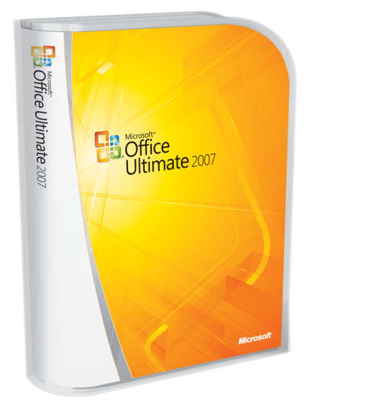
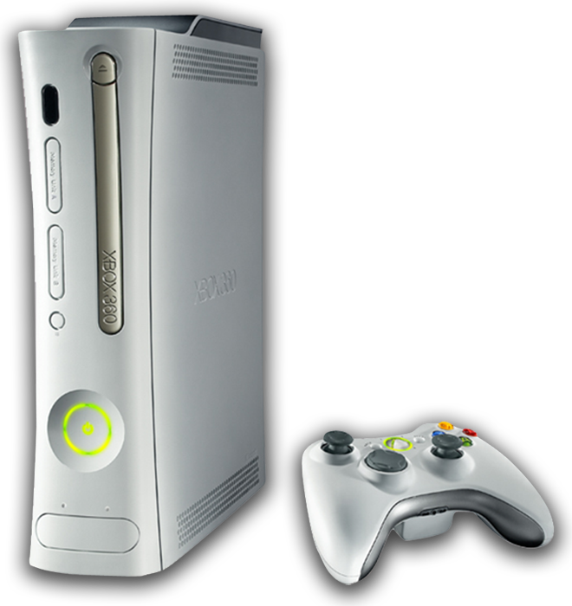
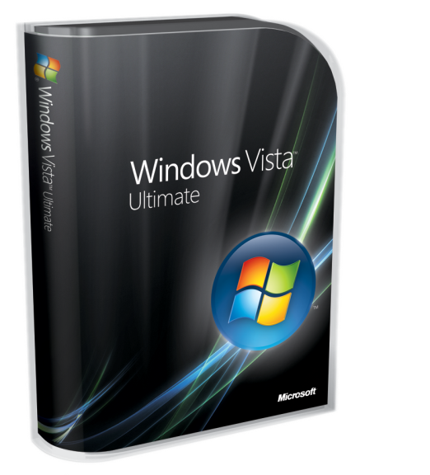



Complete an evaluation on CommNet and
enter to win!

Slide 49
The information herein is for informational purposes only and represents the opinions and views of Project Botticelli and/or Rafal Lukawiecki. The material presented is not certain and may vary based on several factors. Microsoft makes no warranties, express, implied or statutory, as to the information in this presentation.
© 2007 Project Botticelli Ltd & Microsoft Corp. Some slides contain quotations from copyrighted materials by other authors, as individually attributed. All rights reserved. Microsoft, Windows, Windows Vista and other product names are or may be registered trademarks and/or trademarks in the U.S. and/or other countries. The information herein is for informational purposes only and represents the current view of Project Botticelli Ltd as of the date of this presentation. Because Project Botticelli & Microsoft must respond to changing market conditions, it should not be interpreted to be a commitment on the part of Microsoft, and Microsoft and Project Botticelli cannot guarantee the accuracy of any information provided after the date of this presentation. Project Botticelli makes no warranties, express, implied or statutory, as to the information in this presentation. E&OE.

