Slide 1
使用 WPF Toolkit 強化你的 WPF Windows 與 Web 應用程式
曹祖聖
台灣微軟資深講師
jimycao@syset.com
http://teacher.syset.com
MCP, MCP+I, MCSA, MCSE,MCDBA, MCAD, MCSD, MCT, MVP

Slide 2
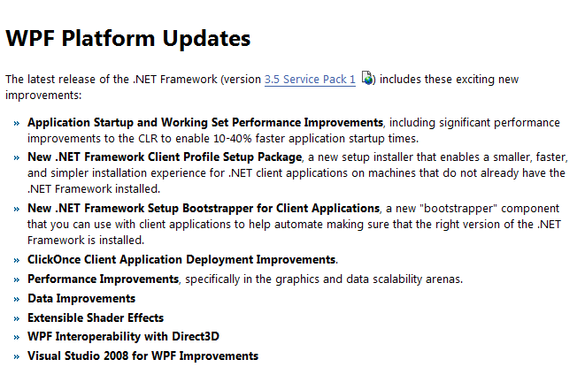
WPF 平台最新更新

Slide 3
大綱
WPF Toolkit
WPF Futures
WPF Ribbon Preview

Slide 4
大綱
WPF Toolkit
WPF Futures
WPF Ribbon Preview

Slide 5
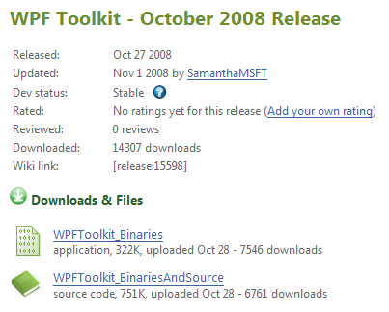
下載 WPF Toolkit
http://www.codeplex.com/wpf/Release/ProjectReleases.aspx?ReleaseId=15598

Slide 6
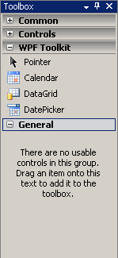
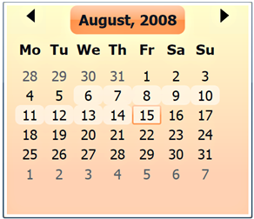
WPF Toolkit
DatePicker/Calendar
DataGrid
VisualStateManager (VSM)

Slide 7
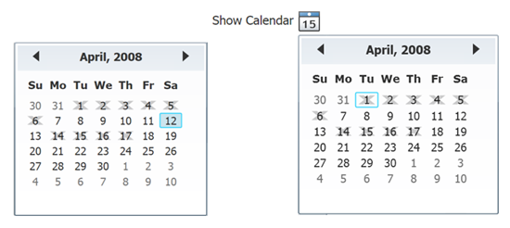
Calendar / DatePicker
CalendarDateRange
<c:Calendar>
<c:Calendar.BlackoutDates>
<c:CalendarDateRange Start="4/1/2008" End="4/6/2008">
<c:CalendarDateRange Start="4/14/2008" End="4/17/2008">
</c:Calendar.BlackoutDates>
<c:Calendar/>

Slide 8
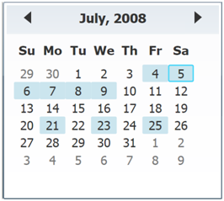
Calendar / DatePicker
SelectionMode
  SingleDate
  SingleRange
  MultipleRange
  None
<c:Calendar SelectionMode="MultipleRange" />

Slide 9
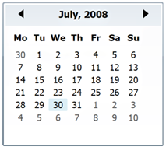
Calendar / DatePicker
FirstDayOfWeek
DisplayDate
<c:Calendar FirstDayOfWeek="Monday" />
<c:Calendar DisplayDate="7/30/2008" />

Slide 10
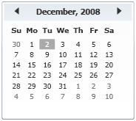
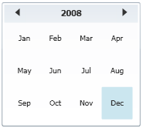
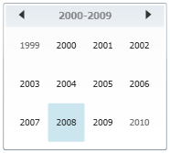
Calendar / DatePicker
DisplayMode
<c:Calendar DisplayMode="Month" />
<c:Calendar DisplayMode="Year" />
<c:Calendar DisplayMode="Decade" />

Slide 11

Calendar / DatePicker
demo

Slide 12
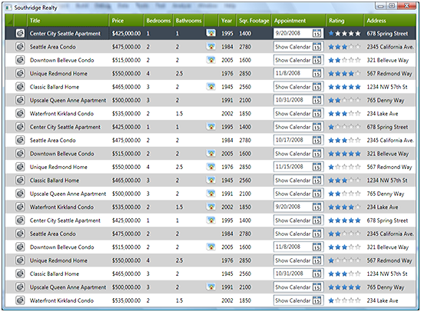
DataGrid
使用資料繫結來自動產生欄位
<dg:DataGrid ItemsSource="{StaticResource myData}"/>

Slide 13
DataGrid
欄位類型
  DataGridTextBoxColumn
  DataGridCheckBoxColumn
  DataGridComboBoxColumn
  DataGridHyperlinkColumn

Slide 14
DataGrid
<dg:DataGrid ItemsSource="{StaticResource myData}"/> >
<dg:DataGrid.Columns>
<dg:DataGridTextColumn Header="No." Width="SizeToCells"
Binding="{Binding CheckNumber}"
IsReadOnly="True"/>
<dg:DataGridTextColumn Header="Date"
Binding="{Binding Date,
StringFormat=d}" />
<dg:DataGridTextColumn Header="Pay To" MinWidth="200"
Binding="{Binding Recipient}"
CanUserSort="False" />
</dg:DataGrid.Columns>
</dg:DataGrid>

Slide 15
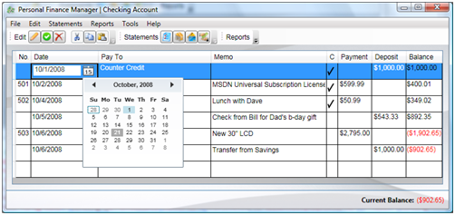
DataGrid
樣版欄位類型
  DataGridTemplateColumn

Slide 16
DataGrid
<dg:DataGridTemplateColumn Header="Date" MinWidth="100">
<dg:DataGridTemplateColumn.CellEditingTemplate>
<DataTemplate>
<dg:DatePicker SelectedDate="{Binding Date}"
SelectedDateFormat="Short" />
</DataTemplate>
</dg:DataGridTemplateColumn.CellEditingTemplate>
<dg:DataGridTemplateColumn.CellTemplate>
<DataTemplate>
<TextBlock Text="{Binding Date, StringFormat=d}" />
</DataTemplate>
</dg:DataGridTemplateColumn.CellTemplate>
</dg:DataGridTemplateColumn>

Slide 17
DataGrid
SelectionUnit
  Cell
    一次選一個儲存格
  FullRow
    一次選一整列
  CellOrRowHeader
    一次選多列或多欄

Slide 18
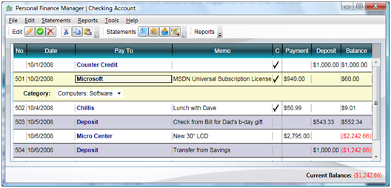
DataGrid
RowDetailsVisibilityMode

Slide 19
DataGrid
<dg:DataGrid x:Name="dg" ItemsSource="{Binding}"
RowDetailsVisibilityMode="VisibleWhenSelected">
<dg:DataGrid.RowDetailsTemplate>
<DataTemplate>
<StackPanel Orientation="Horizontal" Margin="20,0,0,0">
<TextBlock Text="Category:" FontWeight="Bold"/>
<ComboBox IsEditable="True"
ItemsSource="{Binding Source=
{x:Static Data:CheckBook.Categories}}"
Text="{Binding Category}" />
</StackPanel>
</DataTemplate>
</dg:DataGrid.RowDetailsTemplate>
</dg:DataGrid>

Slide 20
DataGrid
demo

Slide 21
Visual State Manager (VSM)
用來處理控制項的外觀改變
Visual States
  描述控制 項的外觀狀況
  例如: "Normal", "MouseOver", "Pressed", "Disabled",
  "Focused", and "Unfocused"
State Transitions
  描述狀態的改變與轉移方式
  例如: 從 "Normal" 到 "MouseOver"
  狀態轉移也可以使用程式碼來做:
VisualStateManager.GoToState(this, "PressedState", true)

Slide 22
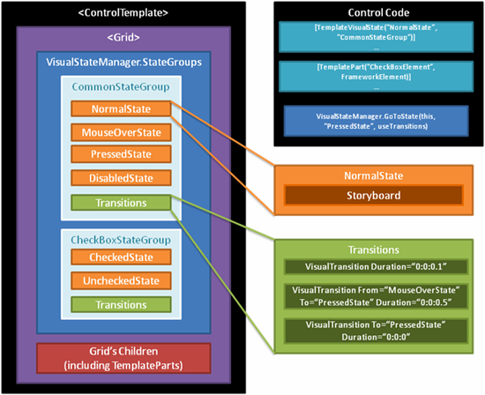
VisualStateManager (VSM)

Slide 23
VSM XAML 定義
<VisualStateGroup x:Name="CommonStateGroup">
<VisualState x:Name="MouseOverState">
<Storyboard>
<DoubleAnimationUsingKeyFrames
Storyboard.TargetName="Halo"
Storyboard.TargetProperty="(UIElement.Opacity)"
BeginTime="00:00:00" RepeatBehavior="Forever">
<SplineDoubleKeyFrame KeyTime="00:00:00.2" Value="0.008"/>
<SplineDoubleKeyFrame KeyTime="00:00:00.5" Value="0.009"/>
</DoubleAnimationUsingKeyFrames>
</Storyboard>
</VisualState>
...
</VisualStateGroup>

Slide 24
VSM State Transitions 定義 #1
預設 StateTransition
  在 VisualStateGroup 中，從任何一個 VisualState 轉變到任何一個 VisualState 時所要套用的 Transition
<VisualStateGroup x:Name="CommonStateGroup">
...
<VisualStateGroup.Transitions>
<VisualTransition Duration="0:0:0.1"/>
</VisualStateGroup.Transitions>
</VisualStateGroup>

Slide 25
VSM State Transitions 定義 #2
指定 StateTransition
  在 VisualStateGroup 中，從某一個 VisualState 轉變到另一個 VisualState 時所要套用的 Transition
<VisualStateGroup x:Name="CommonStateGroup">
...
<VisualStateGroup.Transitions>
...
<VisualTransition
From="MouseOver" To="Pressed" Duration="0:0:0.1" />
</VisualStateGroup.Transitions>
</VisualStateGroup>

Slide 26
VSM State Transitions 定義 #3
在 StateTransition 中使用 Storyboard 做動畫
<VisualStateGroup x:Name="CommonStateGroup">
...
<VisualStateGroup.Transitions>
...
<VisualTransition
From="MouseOver" To="Pressed" Duration="0:0:0.1">
<Storyboard>
<ColorAnimation Storyboard.TargetName="btnOK"
Storyboard.TargetProperty="Color" To="Red" /> </Storyboard>
</VisualTransition>
</VisualStateGroup.Transitions>
</VisualStateGroup>

Slide 27
VisualStateManager (VSM)
demo

Slide 28
大綱
WPF Toolkit
WPF Futures
WPF Ribbon Preview

Slide 29
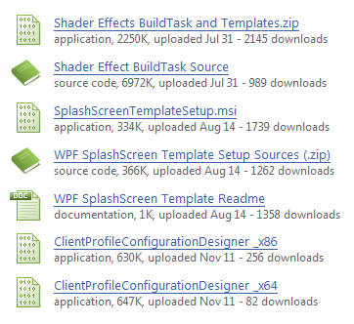
下載 WPF Futures
http://www.codeplex.com/wpf/Release/ProjectReleases.aspx?ReleaseId=14962

Slide 30
WPF Futures
現在
  Splash Screen
  Client Profile Configuration Designer
  Shader Effects
未來
  AnimatedStackPanel
  BreadcrumbBar
  SuggestBox
  ProgressBar

Slide 31
SplashScreen
demo

Slide 32
Client Profile Configuration Designer
功 能
  客製化安裝畫面: 位置、大小、字型、背景、…
  設定必要安裝元件檢查: 檔案、登錄、已安裝程式、…
  設定安裝方式: Windows, Web, …
  支援偵錯功能
安裝要件
  Windows XP SP2, Vista, Windows Server 2003, 2008
  .NET Framework3.5 Service Pack 1

Slide 33
Client Profile Configuration Designer
demo

Slide 34
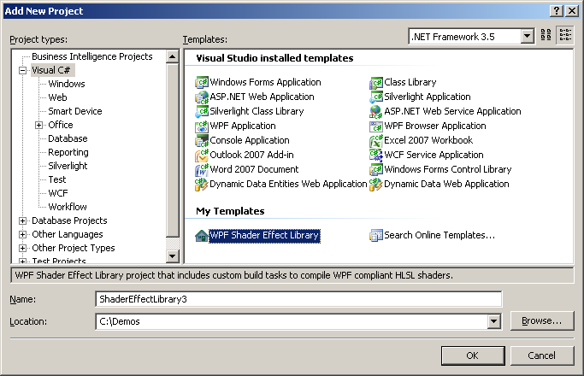
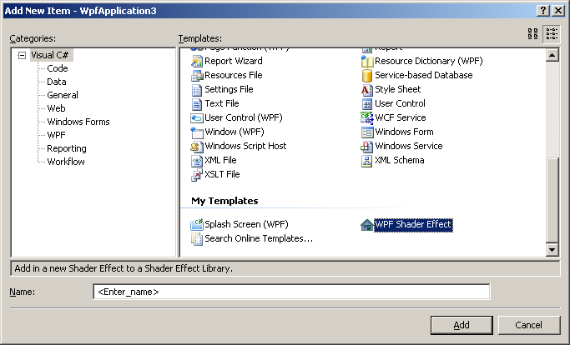
Shader Effects
目前有 26 種特效可直接使用
  展示: 請按我
可以自行開發特效物件 .fx 檔
  將 Template.zip 直接解壓縮到
    C:\Users\[使用者名稱]\Documents\Visual Studio 2008

Slide 35
ShaderEffect
demo

Slide 36
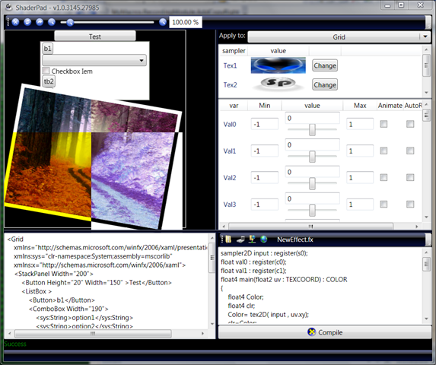
ShaderPad
下載: http://www.codeplex.com/ShaderPad

Slide 37
ShaderPad
demo

Slide 38
大綱
WPF Toolkit
WPF Futures
WPF Ribbon Preview

Slide 39
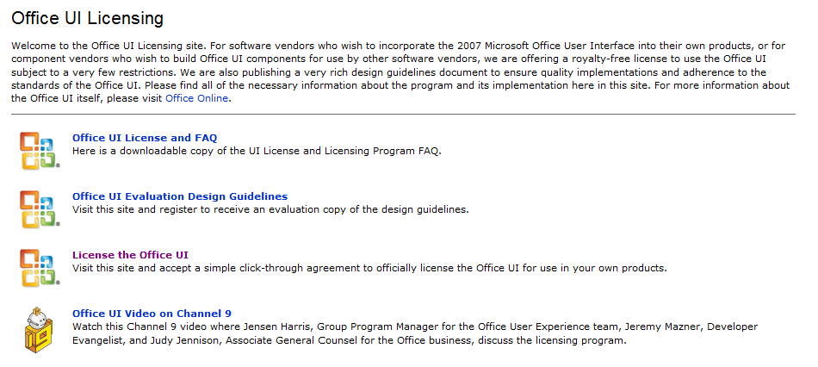
下載 WPF Ribbon Preview #1
註冊與下載說明
  http://www.codeplex.com/wpf/Wiki/View.aspx?title=WPF%20Ribbon%20Preview
WPF Ribbon 下載: http://msdn.microsoft.com/officeui

Slide 40
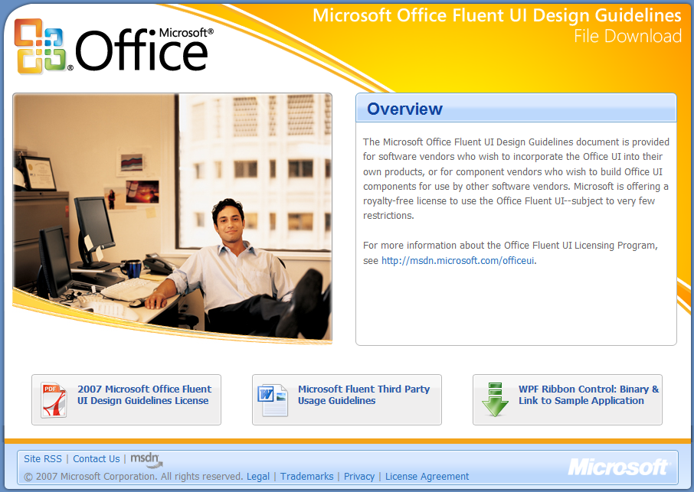
下載 WPF Ribbon Preview #2

Slide 41
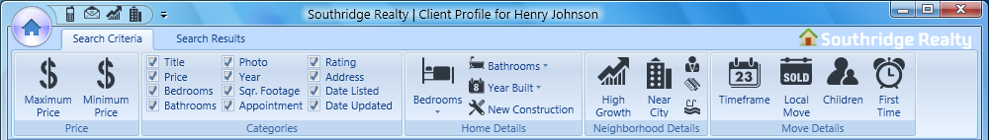
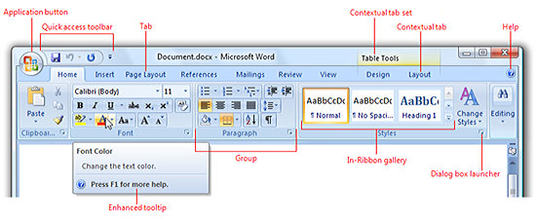
Office Ribbon

Slide 42
Ribbon 基本結構
<r:RibbonTab Label="Banking">
<r:RibbonGroup>
<r:RibbonButton Command="me:AppCommands.Cut"/>
<r:RibbonButton Command="me:AppCommands.Copy"/>
<r:RibbonButton Command="me:AppCommands.Paste"/>
</r:RibbonGroup>
<r:RibbonGroup>
<r:RibbonButton Command="me:AppCommands.AddNew"/>
<r:RibbonButton Command="me:AppCommands.Clear" />
<r:RibbonButton Command="me:AppCommands.Delete"/>
</r:RibbonGroup>
<r:RibbonGroup>
<r:RibbonButton Command="me:AppCommands.DownloadStatements"/>
<r:RibbonButton Command="me:AppCommands.DownloadCreditCards"/>
<r:RibbonButton Command="me:AppCommands.Transfer"/>
</r:RibbonGroup>
</r:RibbonTab>

Slide 43
RibbonCommand
<r:Ribbon>
<r:Ribbon.Resources>
<r:RibbonCommand x:Key="SaveCommand"
CanExecute="SaveCommand_CanExecute"
Executed="SaveCommand_Executed"
LabelTitle="Save"
SmallImageSource="Images\SaveIconSmall.png"
LargeImageSource="Images\SaveIconLarge.png"
ToolTipTitle="Save"
ToolTipDescription="Save your work." />
<r:RibbonCommand x:Key="AnotherCommand"
...
</r:Ribbon.Resources>
…
</r:Ribbon>

Slide 44
RibbonCommand
<r:Ribbon>
...
<r:RibbonTab Label="Home">
<r:RibbonGroup Command="{StaticResource Group1Command}">
<r:RibbonButton Command="{StaticResource SaveCommand}"/>
<r:RibbonButton Command="{StaticResource NewCommand}"/>
<r:RibbonButton Command="{StaticResource OpenCommand}"/>
</r:RibbonGroup>
<r:RibbonGroup Command="{StaticResource Group2Command}">
<r:RibbonButton Command="{StaticResource ClearCommand}"/>
<r:RibbonButton Command="{StaticResource DeleteCommand}" />
<r:RibbonButton Command="{StaticResource UndoCommand}"/>
<r:RibbonButton Command="{StaticResource RedoCommand}"/>
</r:RibbonGroup>
</r:RibbonTab>
</r:Ribbon>

Slide 45
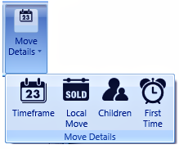
Ribbon 圖示排列與大小
<r:RibbonGroup Name="MoveDetails">
<r:RibbonGroup.Command>
<r:RibbonCommand LabelTitle="Move Details"
SmallImageSource="{StaticResource TimeframeIconDark}"/>
</r:RibbonGroup.Command>
…
<r:RibbonToggleButton Command="{StaticResource TimeFrameCommand}" />
<r:RibbonToggleButton Command="{StaticResource LocalMoveCommand}" />
<r:RibbonToggleButton Command="{StaticResource ChildrenCommand}" />
<r:RibbonToggleButton Command="{StaticResource
FirstTimeBuyerCommand}" />
</r:RibbonGroup>

Slide 46



Ribbon 排列與圖示大小
<r:RibbonGroup Name="MoveDetails">
…
<r:RibbonGroup.GroupSizeDefinitions>
<r:RibbonGroupSizeDefinitionCollection>
<r:RibbonGroupSizeDefinition>
<r:RibbonControlSizeDefinition ImageSize="Large"
IsLabelVisible="True"/>
<r:RibbonControlSizeDefinition ImageSize="Large"
IsLabelVisible="True"/>
<r:RibbonControlSizeDefinition ImageSize="Large"
IsLabelVisible="True"/>
<r:RibbonControlSizeDefinition ImageSize="Large"
IsLabelVisible="True"/>
</r:RibbonGroupSizeDefinition>
…
<r:RibbonGroupSizeDefinition IsCollapsed="True"/>
</r:RibbonGroupSizeDefinitionCollection>
</r:RibbonGroup.GroupSizeDefinitions>
</r:RibbonGroup>

Slide 47
Ribbon 排列順序
<r:RibbonTab Label="Search Criteria"
GroupSizeReductionOrder="Home,Price,Home,Home,Price,Categories">
<r:RibbonGroup Name="Price">
...
</r:RibbonGroup>
<r:RibbonGroup Name="Categories">
...
</r:RibbonGroup>
<r:RibbonGroup Name="Home">
...
</r:RibbonGroup>
</r:RibbonTab>

Slide 48
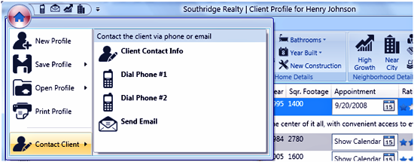
Ribbon Application Menu
RibbonApplicationSplitMenuItems
RibbonApplicationMenuItems

Slide 49
Ribbon Application Menu
<r:Ribbon.ApplicationMenu>
<r:RibbonApplicationMenu>
<r:RibbonApplicationMenu.Command>
<r:RibbonCommand
Executed="OnCloseApplication" LabelTitle="Application Button"
LabelDescription="Close the application."
SmallImageSource=“Coins.png" LargeImageSource=“Coins.png"
ToolTipTitle="Personal Finance Manager"
ToolTipDescription="Click here to close …" />
</r:RibbonApplicationMenu.Command>
<r:RibbonApplicationMenuItem>
<r:RibbonApplicationMenuItem.Command>
<r:RibbonCommand LabelTitle="_Close"
LabelDescription="Close the Application"
Executed="OnCloseApplication" />
</r:RibbonApplicationMenuItem.Command>
</r:RibbonApplicationMenuItem>
</r:RibbonApplicationMenu>
</r:Ribbon.ApplicationMenu>

Slide 50
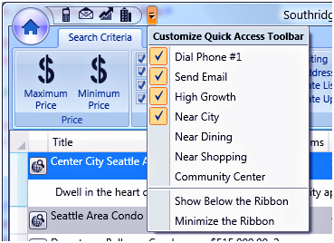
RibbonQuickAccessToolBar

Slide 51
RibbonQuickAccessToolBar
<r:Ribbon.QuickAccessToolBar>
<r:RibbonQuickAccessToolBar>
<r:RibbonToggleButton Command="{StaticResource Phone1Command}"
r:RibbonQuickAccessToolBar.Placement="InCustomizeMenuAndToolBar"/>
<r:RibbonToggleButton Command="{StaticResource EmailCommand}"
r:RibbonQuickAccessToolBar.Placement="InCustomizeMenuAndToolBar"/>
<r:RibbonToggleButton Command="{StaticResource HighGrowthCommand}"
r:RibbonQuickAccessToolBar.Placement="InCustomizeMenuAndToolBar"/>
<r:RibbonToggleButton Command="{StaticResource NearCityCenterCommand}"
r:RibbonQuickAccessToolBar.Placement="InCustomizeMenuAndToolBar"/>
<r:RibbonToggleButton Command="{StaticResource NearDiningCommand}"
r:RibbonQuickAccessToolBar.Placement="InCustomizeMenu"/>
<r:RibbonToggleButton Command="{StaticResource NearShoppingCommand}"
r:RibbonQuickAccessToolBar.Placement="InCustomizeMenu"/>
<r:RibbonToggleButton Command="{StaticResource RecCenterCommand}"
r:RibbonQuickAccessToolBar.Placement="InCustomizeMenu"/>
</r:RibbonQuickAccessToolBar>
</r:Ribbon.QuickAccessToolBar>

Slide 52
WPF Ribbon Preview
demo

Slide 53
結論
透過以下三組 WPF 元件，讓你的應用程式再升級 !
  WPF Toolkit
  WPF Futures
  WPF Ribbon Preview
這些功能未來會加入正式的 WPF Framework 中 !

Slide 54
參考資料
聖哥的資訊站
  http://teacher.allok.com.tw
Windows Presentation Foundation (WPF)
  http://www.codeplex.com/wpf
  http://windowsclient.net/wpf/

Slide 55


