Slide 1
利用Silverlight Toolkit 豐富你的Web應用程式
Session Code:MSDN
董大偉
Consultant Service Manager
K2 SourceCode
MSDN講座專屬講師

Slide 2
講師…
台灣微軟TechED 2007, 2008 講師
台灣微軟MSDN講座專屬講師
微軟最有價值專家(MVP)
Run!PC專欄作者
博碩文化、旗標出版作者
企業機構技術顧問、教育訓練講師
董大偉
David@StudyHost.Com
http://studyhost.blogspot.com/

Slide 3
解決方案總是從問題而來 - Develop Rich Web Application with Silverlight Toolkit
RIA?
我為何需要Rich?
RIA為了解決什麼樣的問題?

Slide 4
解決方案總是從問題而來 - Develop Rich Web Application with Silverlight Toolkit
第一次需求訪談
User
我需要一個表格
表格資料需要連結資料庫
SA→沒問題 (小場面, 用GridView就可以了)

Slide 5
解決方案總是從問題而來 - Develop Rich Web Application with Silverlight Toolkit
第二次需求訪談
User
我需要一個表格,
表格資料需要連結資料庫,
使用者可以在表格中填入數據
數據可以即時編輯，可以即時修改、儲存
SA→這樣?…嗯…沒問題 (GridView加上AJAX應該就可以了)

Slide 6
解決方案總是從問題而來 - Develop Rich Web Application with Silverlight Toolkit
第三次需求訪談
User
我需要一個表格,
表格資料需要連結資料庫
使用者可以在表格中填入數據，可以即時編輯，可以即時修改
我的表格要像Excel一樣可以拖曳欄位改變位置、資料要可以排序、要可以固定或隱藏欄位…嗯…最好還有計算功能…
SA→嗯…這樣?…這個…我們需要評估一下 (………...)

Slide 7
解決方案總是從問題而來 - Develop Rich Web Application with Silverlight Toolkit
第四次需求訪談…如果還有的話
User
我需要一個表格,
表格資料需要連結資料庫
使用者可以在表格中填入數據，可以即時編輯，可以即時修改
我的表格要像Excel一樣可以拖曳欄位改變位置、資料要可以排序、要可以固定或隱藏欄位…嗯…最好還有計算功能…
編輯完資料之後，順便在旁邊產生圖表…
SA→(…….) (這個客戶是看我們不順眼嗎?)

Slide 8
解決方案總是從問題而來 - Develop Rich Web Application with Silverlight Toolkit
Web Application典型的障礙
類似Excel功能的Grid
動態顯示、可以和使用者互動的圖表
圖形化、視覺化、即時的數位儀錶板
隨著需求訪談次數(釐清客戶實際需求後)，往往規格變大, 功能變多, 成本變高…
但客戶滿意度呢? 不見得相對提高!!!

Slide 9
解決方案總是從問題而來 - Develop Rich Web Application with Silverlight Toolkit
Silverlight 可以提供什麼?
拜託，真的不只是搞炫而已…
高互動性以及網頁上豐富的可能性…
你可能錯過了什麼? http://studyhost.blogspot.com/

Slide 10
本場次大綱 - Develop Rich Web Application with Silverlight Toolkit
Silverlight Toolkit介紹與使用技巧
一般控件
輸入控件
圖表控件(DataVisualization)
主題樣式(Theme)
Silverlight控件
Silverlight Control 與 User Control 的使用與開發

Slide 11
一般控件 Silverlight Toolkit
位於Microsoft.Windows.Controls.dll
AutoCompleteBox
DockPanel
Expander
HeaderedContentControl
HeaderedItemsControl
Label
TreeView
TreeViewItem
ViewBox
WrapPanel

Slide 12
輸入控件 Silverlight Toolkit
位於Microsoft.Windows.Controls.Input.dll
NumericUpDown
ButtonSpinner
UpDownBase

Slide 13
圖表相關控件 Silverlight Toolkit
位於Microsoft.Windows.Controls.DataVisualization.dll
支援圖表種類
Bar Chart
Column Chart
Line Chart
Pie Chart
Scatter Chart

Slide 14
主題樣式相關功能 Silverlight Toolkit
位於Microsoft.Windows.Controls.Theming.dll
可透過Xaml Code為場景中的控件隨意替換主題樣式
透過ImplicitStyleManager可動態套用主題樣式
內建六套主題樣式
可自行創建主題樣式

Slide 15
-使用Silverlight Toolkit豐富你的Web應用程式 -
Silverlight Toolkit中的基本控件

Slide 16
一般控件 - AutoCompleteBox Silverlight Toolkit
支援中文的自動完成功能
可設定為搜尋模式
可選擇是否要支援文字自動填入功能
<controls:AutoCompleteBox x:Name="AutoCompleteBox1" Width="200" Height="30" Margin="90,8,210,0" VerticalAlignment="Top" FontSize="16"/>
AutoCompleteTextBox

Slide 17
AutoCompleteBox-SearchMode
None | 不使用搜尋模式，所有符合條件的資料都將顯示出來
StartsWith | 不管大小寫，只要開頭符合的就顯示出來
StartsWithCaseSensitive | 區分大小寫，只要開頭符合的就顯示出來
Contains | 不管大小寫，只要符合部分文字就顯示出來
ContainsCaseSensitive | 區分大小寫，只要符合部分文字就顯示出來
Equals | 不管大小寫，完全相同的資料才會顯示出來
EqualsCaseSensitive | 區分大小寫，完全相同的資料才會顯示出來
Custom | 客製化模式

Slide 18
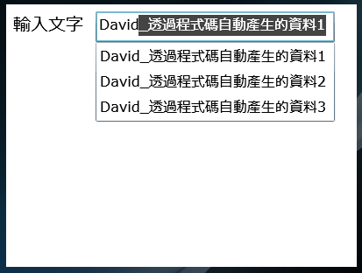
一般控件 - AutoCompleteBox Silverlight Toolkit
可透過程式碼動態產生清單資料
Private Sub AutoTextBox1_Populating(ByVal sender As Object, ByVal e As PopulatingEventArgs) Handles AutoTextBox1.Populating
CType(sender, AutoCompleteBox).ItemsSource = dat
End Sub
AutoCompleteTextBox_Dynamic.xaml

Slide 19
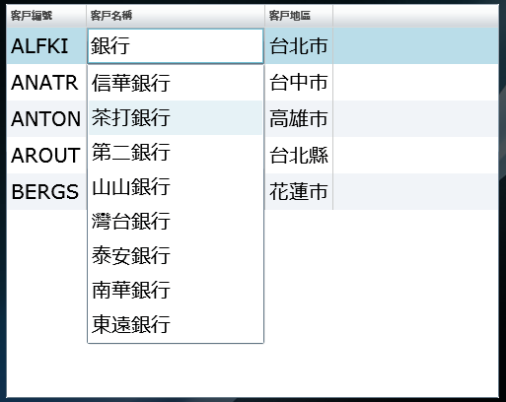
一般控件 - AutoCompleteBox Silverlight Toolkit
支援DataGrid進行清單編輯
建立DataGrid欄位樣板
將欄位樣版改為 AutoCompleteBox
設定AutoCompleteBox 資料來源
AutoCompleteTextBox_DataGrid.

Slide 20
一般控件 - WrapPanel Silverlight Toolkit
可放置多個控件的容器
容器中的控件可依照容器的大小自動折行
可設定走向為水平或垂直
<Grid x:Name="LayoutRoot" Background="#FF191919">
<controls:WrapPanel Margin="8,8,8,8" Orientation="Horizontal">
<StackPanel Orientation="Horizontal" >
<TextBlock Foreground="White" FontSize="16" Margin="5">姓名：</TextBlock>
<TextBox Width="150" Height="30"></TextBox>
</StackPanel>
<StackPanel Orientation="Horizontal" >
<TextBlock Foreground="White" FontSize="16" Margin="5">性別：</TextBlock>
<TextBox Width="30" Height="30" Text="男"></TextBox>
</StackPanel>
???

Slide 21
一般控件 - DockPanel Silverlight Toolkit
可放置多個控件的容器
容器中的控件可設置錨定(Dock)位置為Top, Bottom, Left, Right其中之一
LastChildFill屬性決定容器中的最後一個物件是否要填滿DockPanel
<controls:DockPanel Margin="10" LastChildFill="False">
<Rectangle Height="30" controls:DockPanel.Dock="Top" Fill="#FFFF0000" Stroke="#FF000000" />
<Rectangle Height="30" controls:DockPanel.Dock="Bottom" Fill="#FFFF0000" Stroke="#FF000000" />
</controls:DockPanel>

Slide 22
一般控件 - DockPanel Silverlight Toolkit
透過程式碼設置Dock位置
WrapPanel1.SetValue( DockPanel.DockProperty, Microsoft.Windows.Controls.Dock.Top )

Slide 23
一般控件 - ViewBox Silverlight Toolkit
可放置單一控件的容器
在視覺效果上盡可能的將內含控件填滿該容器內的最大範圍
<UserControl Width="500" Height="300">
<Grid x:Name="LayoutRoot" Background="White">
<controls:Viewbox>
<TextBox Width="100" Height="25"></TextBox>
</controls:Viewbox>
</Grid>
</UserControl>

Slide 24
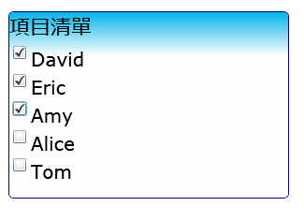
一般控件 - HeaderedItemsControl Silverlight Toolkit
可製作 標題 / 項目 清單
項目清單可透過資料繫結的方式來顯示
支援樣式改變顯示外觀
<controls:HeaderedItemsControl Height="200" FontSize="20" Header="項目清單" Template="{StaticResource HeaderItemTemplate}" x:Name="HeaderedItemsControl1" >
<controls:HeaderedItemsControl.ItemTemplate>
<DataTemplate>
<CheckBox Content="{Binding}"></CheckBox>
</DataTemplate>
</controls:HeaderedItemsControl.ItemTemplate>
</controls:HeaderedItemsControl>

Slide 25
一般控件 - ExpanderControl Silverlight Toolkit
可展開/收回的HeaderedContent控件
可透過ExpandDirection決定展開方向
可自由套用樣版顯示
<controls:Expander FontSize="16" ExpandDirection="Down" Header="本周A組業績圖表">
<controls:Expander.HeaderTemplate>
<DataTemplate>
(…Header內容…)
</DataTemplate>
</controls:Expander.HeaderTemplate>
(…Content內容…)
</controls:Expander>

Slide 26
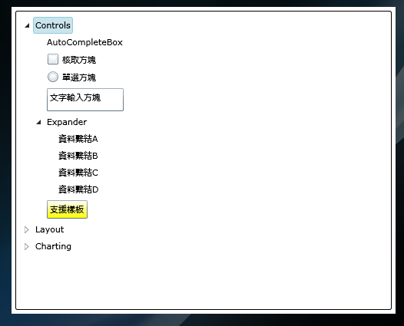
一般控件 - TreeView Silverlight Toolkit
支援樣板
支援資料繫結
可將節點設置為任意控件
<controls:TreeView Margin="5" x:Name="TreeView1">
<controls:TreeViewItem Header="Controls">
<controls:TreeViewItem Header="AutoCompleteBox" />
<controls:TreeViewItem>
<controls:TreeViewItem.Header>
<CheckBox Content="核取方塊"></CheckBox>
</controls:TreeViewItem.Header>
</controls:TreeViewItem>
<controls:TreeViewItem>

Slide 27
-使用Silverlight Toolkit豐富你的Web應用程式 -
Silverlight Toolkit中的輸入控件

Slide 28
輸入控件 - ButtonSpinner Silverlight Toolkit
具有spin事件的增減切換鈕
透過e.Direction回傳值決定增減
<StackPanel HorizontalAlignment="Center" Orientation="Horizontal">
<TextBox x:Name="TextBox1" Height="29" Width="105" Text="一月" TextWrapping="Wrap" FontSize="16" Background="#FFB2FFF4"/>
<input:ButtonSpinner Spin="ButtonSpinner_Spin" />
</StackPanel>
UndownControl

Slide 29
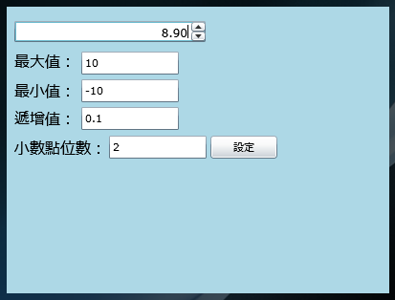
輸入控件 - NumericUpDown Silverlight Toolkit
Maximum
Minimum
Increment
DecimalPlaces
UndownControl

Slide 30
輸入控件 - UpDownBase Silverlight Toolkit
利用UpDownBase客製化自己的控件
繼承Inherits UpDownBase(Of T)
實作OnIncrement、OnDecrement、 FormatValue、 ParseValue
使用TimeUpDown
TimerUpDown

Slide 31
-使用Silverlight Toolkit豐富你的Web應用程式 -
Silverlight Toolkit中的繪圖控件

Slide 32
支援的圖表種類 Silverlight DataVisualization
Bar Chart
Column Chart
Line Chart
Pie Chart
Scatter Chart

Slide 33
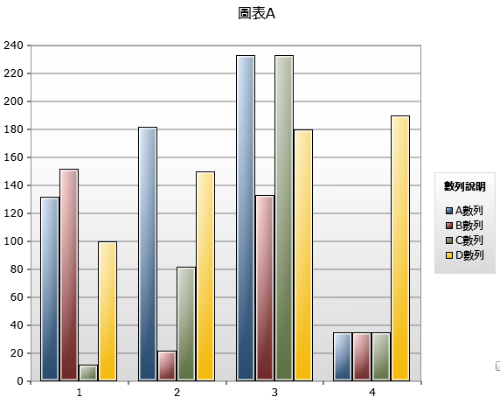
圖表結構 Silverlight DataVisualization
圖表標題 (Title)
圖表數據組 (Chart Series)
圖例 (Legend)
圖表繪製區 (Plot Area)
軸線 (Axis)

Slide 34
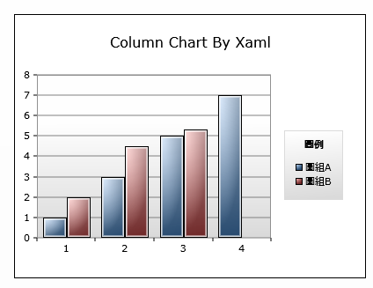
以Xaml Code表達一張圖表 Silverlight DataVisualization
ColumnChartByXaml.xaml
<Grid x:Name="LayoutRoot" Background="White">
<charting:Chart Title="Column Chart By Xaml" LegendTitle="圖例" >
<charting:Chart.Series>
<charting:ColumnSeries Title="圖組A">
<charting:ColumnSeries.ItemsSource>
<controls:ObjectCollection>
<sys:Int32>1</sys:Int32>
<sys:Int32>3</sys:Int32>
<sys:Int32>5</sys:Int32>
<sys:Int32>7</sys:Int32>
</controls:ObjectCollection>
</charting:ColumnSeries.ItemsSource>
</charting:ColumnSeries>
(…略…)
</charting:Chart.Series>
</charting:Chart>
</Grid>
Notes:
Width="400" Height="300"
xmlns:sys="clr-namespace:System;assembly=mscorlib"
xmlns:controls="clr-namespace:Microsoft.Windows.Controls;assembly=Microsoft.Windows.Controls"
>
<Grid x:Name="LayoutRoot" Background="White">
<charting:Chart Title="Column Chart By Xaml" LegendTitle="圖例" >
<charting:Chart.Series>
<charting:ColumnSeries Title="圖組A">
<charting:ColumnSeries.ItemsSource>
<controls:ObjectCollection>
<sys:Int32>1</sys:Int32>
<sys:Int32>3</sys:Int32>
<sys:Int32>5</sys:Int32>
<sys:Int32>7</sys:Int32>
</controls:ObjectCollection>
</charting:ColumnSeries.ItemsSource>
</charting:ColumnSeries>
<charting:ColumnSeries Title="圖組B">
<charting:ColumnSeries.ItemsSource>
<controls:ObjectCollection>
<sys:Int32>2.3</sys:Int32>
<sys:Double>4.5</sys:Double>
<sys:Double>5.3</sys:Double>
</controls:ObjectCollection>
</charting:ColumnSeries.ItemsSource>
</charting:ColumnSeries>
</charting:Chart.Series>
</charting:Chart>
</Grid>
</UserControl>

Slide 35
以Xaml Code客製化軸線 Silverlight DataVisualization
<charting:Chart Title="Column Chart By Xaml" LegendTitle="圖例">
<charting:Chart.Axes>
<charting:Axis AxisType="Category" Title="分類項目" Orientation="Horizontal" FontFamily="微軟正黑體" FontSize="16" />
<charting:Axis AxisType="Linear" Title="數值" Orientation="Vertical" Minimum="0" Maximum="30" Interval="5" ShowGridLines="True" ShowTickMarks="True" FontFamily="微軟正黑體" FontSize="16"/>
</charting:Chart.Axes>
<charting:Chart.Series>
<charting:ColumnSeries Title="圖組A">
<charting:ColumnSeries.ItemsSource>
<controls:ObjectCollection>
<sys:Int32>1</sys:Int32>
<sys:Int32>3</sys:Int32>
(…略…)
Notes:
<charting:Chart.Axes>
<charting:Axis AxisType="Category" Title="分類項目" Orientation="Horizontal" FontFamily="微軟正黑體" FontSize="16" />
<charting:Axis AxisType="Linear" Title="數值" Orientation="Vertical" Minimum="0" Maximum="30" Interval="5" ShowGridLines="True" ShowTickMarks="True" FontFamily="微軟正黑體" FontSize="16"/>
</charting:Chart.Axes>

Slide 36
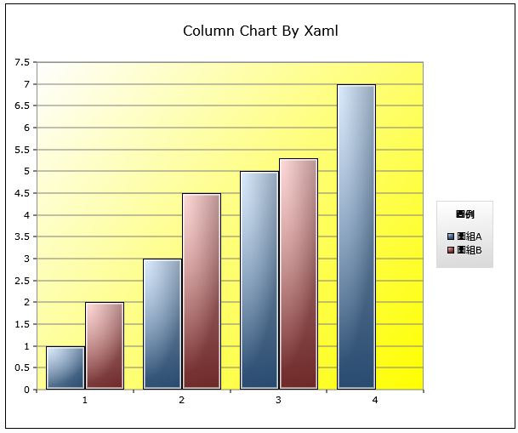
以Xaml Code客製化繪製區域背景 Silverlight DataVisualization
ColumnChartByXaml_test.xaml
<charting:Chart Title="Column Chart By Xaml" LegendTitle="圖例" PlotAreaStyle="{StaticResource MyPlotArea}">
<charting:Chart.Series>
<charting:ColumnSeries Title="圖組A">
<charting:ColumnSeries.ItemsSource>
<controls:ObjectCollection>
<sys:Int32>1</sys:Int32>
(…略…)
Notes:
*********Main.Xaml*********
PlotAreaStyle="{StaticResource MyPlotArea}"
*********App.Xaml*********
<Application.Resources>
<Style TargetType="Grid" x:Name="MyPlotArea">
<Setter Property="Background" >
<Setter.Value>
<LinearGradientBrush StartPoint="0,0" EndPoint="1,1">
<GradientStop Color="White" Offset="0.0"/>
<GradientStop Color="Yellow" Offset="1" />
</LinearGradientBrush>
</Setter.Value>
</Setter>
</Style>
</Application.Resources>

Slide 37
以Xaml Code客製化繪製區域背景 Silverlight DataVisualization
<Application.Resources>
<Style TargetType="Grid" x:Name="MyPlotArea">
<Setter Property="Background" >
<Setter.Value>
<LinearGradientBrush StartPoint="0,0" EndPoint="1,1">
<GradientStop Color="White" Offset="0.0"/>
<GradientStop Color="Yellow" Offset="1" />
</LinearGradientBrush>
</Setter.Value>
</Setter>
</Style>
</Application.Resources>
Notes:
*********Main.Xaml*********
PlotAreaStyle="{StaticResource MyPlotArea}"
*********App.Xaml*********
<Application.Resources>
<Style TargetType="Grid" x:Name="MyPlotArea">
<Setter Property="Background" >
<Setter.Value>
<LinearGradientBrush StartPoint="0,0" EndPoint="1,1">
<GradientStop Color="White" Offset="0.0"/>
<GradientStop Color="Yellow" Offset="1" />
</LinearGradientBrush>
</Setter.Value>
</Setter>
</Style>
</Application.Resources>

Slide 38
以Xaml Code客製化圖表顏色 Silverlight DataVisualization
ColumnChartByXaml_test.xaml
<charting:Chart Title="Column Chart By Xaml" LegendTitle="圖例"
PlotAreaStyle="{StaticResource MyPlotArea}" >
<charting:Chart.StylePalette>
<datavis:StylePalette>
<Style TargetType="Control">
<Setter Property="Background" Value="{StaticResource MyColor1}"/>
</Style>
<Style TargetType="Control">
<Setter Property="Background" Value="{StaticResource MyColor2}"/>
</Style>
</datavis:StylePalette>
</charting:Chart.StylePalette>
<charting:Chart.Series>
<charting:ColumnSeries Title="圖組A">
<charting:ColumnSeries.ItemsSource>
<controls:ObjectCollection>
<sys:Int32>1</sys:Int32>
<sys:Int32>3</sys:Int32> (…略…)
Notes:
*********Main.Xaml*********
<charting:Chart Title="Column Chart By Xaml" LegendTitle="圖例"
PlotAreaStyle="{StaticResource MyPlotArea}" >
<charting:Chart.StylePalette>
<datavis:StylePalette>
<Style TargetType="Control">
<Setter Property="Background" Value="{StaticResource MyColor1}"/>
</Style>
<Style TargetType="Control">
<Setter Property="Background" Value="{StaticResource MyColor2}"/>
</Style>
</datavis:StylePalette>
</charting:Chart.StylePalette>
<charting:Chart.Series>
<charting:ColumnSeries Title="圖組A">
<charting:ColumnSeries.ItemsSource>
<controls:ObjectCollection>
<sys:Int32>1</sys:Int32>
<sys:Int32>3</sys:Int32>
<sys:Int32>5</sys:Int32>
<sys:Int32>7</sys:Int32>
</controls:ObjectCollection>
</charting:ColumnSeries.ItemsSource>
</charting:ColumnSeries>
*********App.Xaml*********
<LinearGradientBrush x:Key="MyColor1" EndPoint="0.5,1" StartPoint="0.5,0">
<GradientStop Color="LightPink" Offset="0" />
<GradientStop Color="Red" Offset="1" />
</LinearGradientBrush>
<LinearGradientBrush x:Key="MyColor2" EndPoint="0.5,1" StartPoint="0.5,0">
<GradientStop Color="LightBlue" Offset="0" />
<GradientStop Color="Blue" Offset="1" />
</LinearGradientBrush>

Slide 39
以Xaml Code客製化圖表顏色 Silverlight DataVisualization
<Application.Resources>
<LinearGradientBrush x:Key="MyColor1" EndPoint="0.5,1" StartPoint="0.5,0">
<GradientStop Color="LightPink" Offset="0" />
<GradientStop Color="Red" Offset="1" />
</LinearGradientBrush>
<LinearGradientBrush x:Key="MyColor2" EndPoint="0.5,1" StartPoint="0.5,0">
<GradientStop Color="LightBlue" Offset="0" />
<GradientStop Color="Blue" Offset="1" />
</LinearGradientBrush> </Application.Resources>
Notes:
*********Main.Xaml*********
<charting:Chart Title="Column Chart By Xaml" LegendTitle="圖例"
PlotAreaStyle="{StaticResource MyPlotArea}" >
<charting:Chart.StylePalette>
<datavis:StylePalette>
<Style TargetType="Control">
<Setter Property="Background" Value="{StaticResource MyColor1}"/>
</Style>
<Style TargetType="Control">
<Setter Property="Background" Value="{StaticResource MyColor2}"/>
</Style>
</datavis:StylePalette>
</charting:Chart.StylePalette>
<charting:Chart.Series>
<charting:ColumnSeries Title="圖組A">
<charting:ColumnSeries.ItemsSource>
<controls:ObjectCollection>
<sys:Int32>1</sys:Int32>
<sys:Int32>3</sys:Int32>
<sys:Int32>5</sys:Int32>
<sys:Int32>7</sys:Int32>
</controls:ObjectCollection>
</charting:ColumnSeries.ItemsSource>
</charting:ColumnSeries>
*********App.Xaml*********
<LinearGradientBrush x:Key="MyColor1" EndPoint="0.5,1" StartPoint="0.5,0">
<GradientStop Color="LightPink" Offset="0" />
<GradientStop Color="Red" Offset="1" />
</LinearGradientBrush>
<LinearGradientBrush x:Key="MyColor2" EndPoint="0.5,1" StartPoint="0.5,0">
<GradientStop Color="LightBlue" Offset="0" />
<GradientStop Color="Blue" Offset="1" />
</LinearGradientBrush>

Slide 40
以Xaml Code表達一張圖表-使用資料繫結 Silverlight DataVisualization
ColumnChart_BindingResource.xaml
<UserControl
(…略…)
xmlns:local="clr-namespace:SilverlightCharting"
Width="600" Height="500"
(…略…)
<Grid x:Name="LayoutRoot" Background="White">
<Grid.Resources>
<local:DataCollection x:Key="DataCollection"/>
</Grid.Resources>
<charting:Chart x:Name="Chart1" Title="標題" LegendTitle="數列">
<charting:Chart.Series>
<charting:ColumnSeries
ItemsSource="{StaticResource DataCollection}"
DependentValueBinding="{Binding Value}"
IndependentValueBinding="{Binding Name}"/>
</charting:Chart.Series>
</charting:Chart>
</Grid>
</UserControl>
Notes:
Width="400" Height="300"
xmlns:sys="clr-namespace:System;assembly=mscorlib"
xmlns:controls="clr-namespace:Microsoft.Windows.Controls;assembly=Microsoft.Windows.Controls"
>
<Grid x:Name="LayoutRoot" Background="White">
<charting:Chart Title="Column Chart By Xaml" LegendTitle="圖例" >
<charting:Chart.Series>
<charting:ColumnSeries Title="圖組A">
<charting:ColumnSeries.ItemsSource>
<controls:ObjectCollection>
<sys:Int32>1</sys:Int32>
<sys:Int32>3</sys:Int32>
<sys:Int32>5</sys:Int32>
<sys:Int32>7</sys:Int32>
</controls:ObjectCollection>
</charting:ColumnSeries.ItemsSource>
</charting:ColumnSeries>
<charting:ColumnSeries Title="圖組B">
<charting:ColumnSeries.ItemsSource>
<controls:ObjectCollection>
<sys:Int32>2.3</sys:Int32>
<sys:Double>4.5</sys:Double>
<sys:Double>5.3</sys:Double>
</controls:ObjectCollection>
</charting:ColumnSeries.ItemsSource>
</charting:ColumnSeries>
</charting:Chart.Series>
</charting:Chart>
</Grid>
</UserControl>

Slide 41
以程式碼動態產生圖表 Silverlight DataVisualization
BarChartbyCode.xaml
Private Sub Button1_Click(ByVal sender As System.Object, ByVal e As System.Windows.RoutedEventArgs)
Dim bs1 As New BarSeries
Dim dat1() As Integer = New Integer() {3, 6, 9, 12}
bs1.ItemsSource = dat1
Me.Chart1.Series.Add(bs1)
End Sub
Notes:
Width="400" Height="300"
xmlns:sys="clr-namespace:System;assembly=mscorlib"
xmlns:controls="clr-namespace:Microsoft.Windows.Controls;assembly=Microsoft.Windows.Controls"
>
<Grid x:Name="LayoutRoot" Background="White">
<charting:Chart Title="Column Chart By Xaml" LegendTitle="圖例" >
<charting:Chart.Series>
<charting:ColumnSeries Title="圖組A">
<charting:ColumnSeries.ItemsSource>
<controls:ObjectCollection>
<sys:Int32>1</sys:Int32>
<sys:Int32>3</sys:Int32>
<sys:Int32>5</sys:Int32>
<sys:Int32>7</sys:Int32>
</controls:ObjectCollection>
</charting:ColumnSeries.ItemsSource>
</charting:ColumnSeries>
<charting:ColumnSeries Title="圖組B">
<charting:ColumnSeries.ItemsSource>
<controls:ObjectCollection>
<sys:Int32>2.3</sys:Int32>
<sys:Double>4.5</sys:Double>
<sys:Double>5.3</sys:Double>
</controls:ObjectCollection>
</charting:ColumnSeries.ItemsSource>
</charting:ColumnSeries>
</charting:Chart.Series>
</charting:Chart>
</Grid>
</UserControl>

Slide 42
以程式碼動態產生圖表 Silverlight DataVisualization
若不採用資料繫結
圖表中的數據是死的
資料來源的數據若修改，圖表中的數據不會改變
若採用資料繫結
需設定DependentValueBinding
需設定IndependentValueBinding
圖表將以動畫方式隨繫結的資料調整而改變

Slide 43
以程式碼動態產生圖表-使用資料繫結 Silverlight DataVisualization
BarChartbyCodeWithBinding.xaml
'建立資料來源
Dim dataSource As DataCollection = New DataCollection
'設定繫結
Private Sub Button1_Click(ByVal sender As System.Object, ByVal e As System.Windows.RoutedEventArgs)
Dim bs1 As New BarSeries
bs1.ItemsSource = dataSource
bs1.DependentValueBinding = New Data.Binding("Value")
bs1.IndependentValueBinding = New Data.Binding("Name")
Me.Chart1.Series.Add(bs1)
End Sub
'增加數據
Private Sub Button2_Click(ByVal sender As System.Object, ByVal e As System.Windows.RoutedEventArgs)
dataSource.Add(New DataItem With {.Name = "Tim", .Value = 150})
End Sub

Slide 44
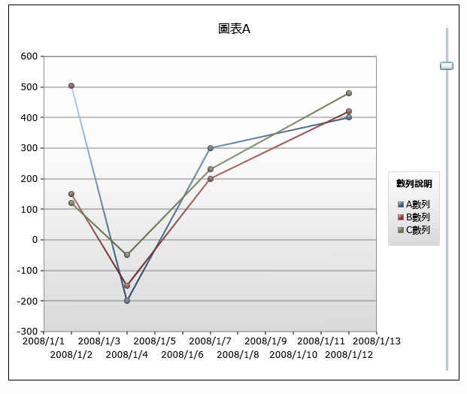
資料繫結 與 動態數據顯示 Silverlight DataVisualization
LineChart.xaml
'動態調整數據
Private Sub Slider_ValueChanged(ByVal sender As System.Object, ByVal e As System.Windows.RoutedPropertyChangedEventArgs(Of System.Double))
If initFlag = False Then Exit Sub
Dim Data1 As LineDataItemCollection = CType(Me.Chart1.Series(0), LineSeries).ItemsSource
Data1(0).Value = e.NewValue
End Sub

Slide 45
資料繫結 與 後端資料庫內容 Silverlight DataVisualization
準備資料
建立LinqToSql(需設定為Unidirectional)
透過Linq抓取資料
透過Silverlight-Enabled WCF傳遞資料
顯示資料
接收資料
轉換成數據組
透過Data Binding呈現圖表

Slide 46
資料繫結 與 後端資料庫內容 -透過Linq抓取資料
DataFromDB.xaml
<OperationContract()> _
Public Function GetStockData() As 產品資料()
Dim db As New cNorthwindDataContext
'搜尋庫存量最高的10筆資料
Dim ret = From c In db.產品資料 Take 10 Select c Order By c.庫存量 Descending
Return ret.ToArray
End Function

Slide 47
資料繫結 與 後端資料庫內容 -非同步調用WCF Service
DataFromDB.xaml
'建立service
Dim WithEvents proxy As ServiceReference1.Service1Client
'調用Service
Private Sub Button1_Click(ByVal sender As System.Object, ByVal e As System.Windows.RoutedEventArgs)
proxy = New ServiceReference1.Service1Client("BasicHttpBinding_Service1", "http://localhost:59252/Service1.svc")
proxy.GetStockDataAsync()
End Sub

Slide 48
資料繫結 與 後端資料庫內容 -非同步調用WCF Service
DataFromDB.xaml
'call back
Private Sub proxy_GetStockDataCompleted(ByVal sender As Object, ByVal e As ServiceReference1.GetStockDataCompletedEventArgs) Handles proxy.GetStockDataCompleted
Dim ret = e.Result
'組出DataCollection
Dim dc As New DataCollection
dc.Clear()
For Each item As ServiceReference1.產品資料 In ret
dc.Add(New DataItem With {.Name = item.產品, .Value = item.庫存量})
Next
'顯示圖表
Dim cs As New BarSeries
cs.ItemsSource = dc
cs.IndependentValueBinding = New Data.Binding("Name")
cs.DependentValueBinding = New Data.Binding("Value")
cs.Foreground = New SolidColorBrush(Colors.Cyan)
cs.Title = "第四季產品庫存量"
Me.Chart1.Series.Add(cs)
End Sub

Slide 49
-使用Silverlight Toolkit豐富你的Web應用程式 -
Silverlight Toolkit中的Themes

Slide 50
Theme與ImplicitStyleManager Silverlight Theme
可透過Xaml Code隨意替換樣式
透過ImplicitStyleManager可動態套用樣式
內建六套樣式
可自行創建樣式

Slide 51
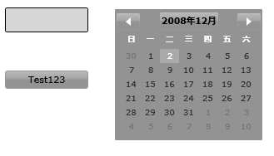
Theme與ImplicitStyleManager Theme與ImplicitStyleManager
透過Xaml指令碼指定主題樣式
<ExpressionDark:ExpressionDarkTheme Margin="0">
<Grid x:Name="LayoutRoot" Background="White">
<Button Width="100" Content="Test123" HorizontalAlignment="Left" Margin="32,129,0,141" />
<TextBox Width="100" Height="30" HorizontalAlignment="Left" VerticalAlignment="Top" Margin="32,53,0,0"/>
<basics:Calendar Margin="164,53,51,74"/>
</Grid>
</ExpressionDark:ExpressionDarkTheme>

Slide 52
Theme與ImplicitStyleManager Theme與ImplicitStyleManager
透過程式碼動態套用主題樣式
Dim uri As New Uri("Themes;component/RainierOrange.xaml", UriKind.Relative)
ImplicitStyleManager.SetResourceDictionaryUri(LayoutRoot, Uri)
ImplicitStyleManager.SetApplyMode(LayoutRoot, ImplicitStylesApplyMode.Auto)
ImplicitStyleManager.Apply(LayoutRoot)

Slide 53
Q & A

Slide 54
© 2008 Microsoft Corporation. All rights reserved. Microsoft, Windows, Windows Vista and other product names are or may be registered trademarks and/or trademarks in the U.S. and/or other countries.
The information herein is for informational purposes only and represents the current view of Microsoft Corporation as of the date of this presentation. Because Microsoft must respond to changing market conditions, it should not be interpreted to be a commitment on the part of Microsoft, and Microsoft cannot guarantee the accuracy of any information provided after the date of this presentation. MICROSOFT MAKES NO WARRANTIES, EXPRESS, IMPLIED OR STATUTORY, AS TO THE INFORMATION IN THIS PRESENTATION.

